Slide 1
Enhancing the use of impact assessment tools in policy making: bridging the gap between science and the policy making community

Slide 2
Impact Assessment: Expectations and Empirical findings
IA Requirements:
Consideration of Economic, Environmental and Social aspects
Quantification of Impacts
Use of Cost Benefit Analysis
Value-free, neutral fact finding
But:
- 22 Case studies in EC (8), Poland (2), UK (5), Denmark (3) and Netherlands (4)
4 out of 22 consider economic, social and environmental aspects substantially (all EC)
In all cases economic impacts have been considered at least formally, social impacts in 13 cases, environmental impacts in 11 cases
Substantial consideration: economic impacts 17, social 7, environmental 8
Overall: Assessment of economic impacts and consultation of respective stakeholder is a well established practice, not the case for social and environmental aspects

Slide 3
EVIA Surveys
Officers: GER (28), UK (21), NL (11)
National IA Procedures:
UK: Regulatory Impact Assessment
NL: 3 separate tests overseen (business, enforcability, environment)
D: informal analysis versus formalised GFA

Slide 4
Economic Analysis

Slide 5
Sceptical on Quantification

Slide 7
Analysis of IA Reports: EU COM, Ireland, UK
Source: Turnpenny et al. 2011

Slide 8
Why is there a gap?
IA and the Policy Process:
Positivist technical-rational view: Speaking (a single) truth to a (single) power
But:
Political System
Evidence based policy making in tension with existing institutions
Policy Regime:
Plurality of Evidence,
Multiple actors and interests
Ambiguity and non-linearity of the political process
Pre-determination and analytical closure
Results:
Symbolic or legitimizing use of knowledge
Use of knowledge to frame the discourse:
Translation and re-combination of knowledge

Slide 9
Improving the Practice
Supply side:
‚Mode 2‘, post-normal science: Diversity, Transdisciplinarity, Responsibility and Quality Standards
Sustainability Science: problem-orientation, interdisciplinarity, transdisciplinarity
Division of Work, Specialisation and Integration
Tools and data
Analysis of the context
Demand side:
Adaptation to the institutional context and integration in the policy process
inter-departmental co-operation
co-ordination across policy levels
Participation
Quality Assurance

Slide 10
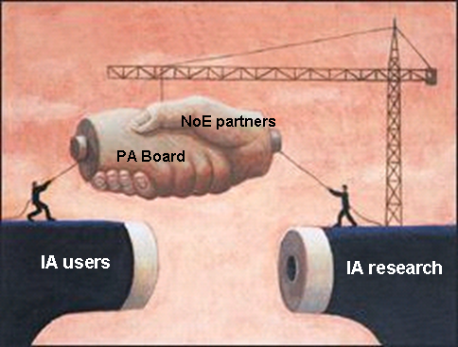
LIAISE Network of Excellence
LIAISE: 15 partner from FP6/FP7 IA projects
Community of Researchers:
Publications
Meetings
Training
Research Agenda
www.liaise-noe.eu
Tools and Toolbox
Contextualising knowledge
Combining knowledge
alpha.liaise-toobox.eu

