Slide 1
Evaluating the environmental subsidies to local authorities in Flanders (Belgium)
A study performed by TRITEL for the Flemish environmental departement
Annick Gommers

Slide 2
Evaluating the environmental subsidies to local authorities in Flanders (Belgium)
Policy context in Flanders (Belgium)
Objective of the evaluation study
Methodology and results:
Reaching the municipalities
Effectiveness of the subsidies: databases + web inquiry
Hypothesis, qualitative evaluation, ...: focus groups, interviews
Recommendations:
Based on SWOT
General pathway to follow in order to decide whether subsidies have to be given or not (possible other type of financing) → translation to each of the subsidies
Notes:
Advantage of the collective evaluation of different instruments to the same target group

Slide 3
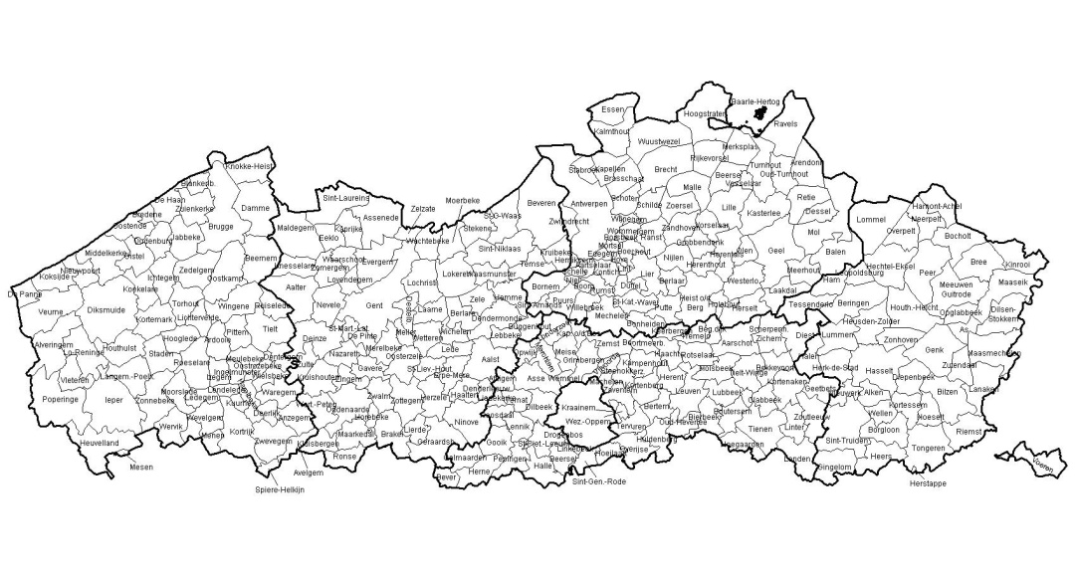
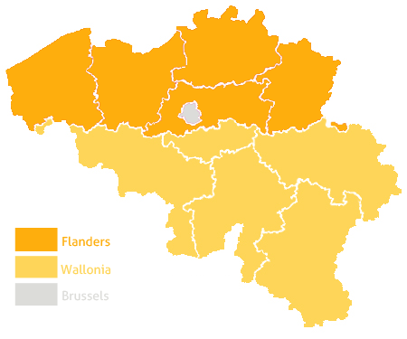
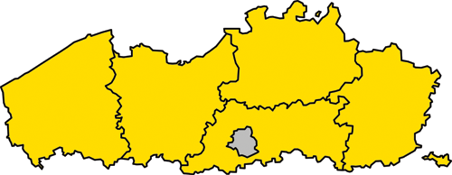
Policy context: different competent levels for environmental policy in Belgium
Belgium: competent for few environmental questions
Import / export
Product norms
Marine environment
Flemish region: competent for all other environmental policy
Biodiversity policy
Air & water quality policy
Waste & sustainable material policy
Quality of the countriside policy
Etc.
308 Municipalities
Own environmental policy
Contribution to the realization of the Flemish environmental policy
Obligations / legal duties
Stimulation (subsidies)

Slide 4
Diversity in objectives for which Flanders wants a contribution from the local authorities
Flemish environment department
Reduce nuisance (noise, odour, light, …)
Flemish waste agency
Reduce the waste production of households
Subsidy for recording complaints
Flemish soil protection agency
Subsidy for waste collection infrastruction
Reduce erosion
Flemish enironment agency
Subsidy for measures against erosion
Improve surface water quality
Subsidy for installing drains and sewers
Flemish agency for open space
Flemish forest & nature agency
Enhance and preserve the open space
Extend the surface of forests and nature reserves
Subsidy for conservation, maintenance
Subsidy for the acquisition
Subsidy for the ecological management of forests
Preserve biodiversity

Slide 5
Evaluation of the subsidies in order to detect possibilities for improvement
Objective of the study: formulate proposals for improvement of the subsidies from the Flemish to the local authorities
Instead of 12 in-depth studies, 1 overall study
12 subsidies
Study of the 12 subsidies – quantitative base for evaluating their effectiveness
Integrated evaluation of the 3 most important subsidies – qualitative (testing hypotheses + efficiency + other evaluation criteria)
Focus on 3 subsidies
SWOT + general possibilities for improvement → recommendations (overall + translation to each of the subsidies)
Generalisation
Notes:
This means: no in-depth analysis of all processes, no in-depth xxx
Recommendations on two levels: general (overall) recommendations + specific recommendations

Slide 6
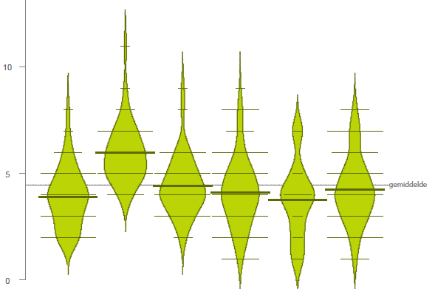
Evaluating the reaching of municipalities: not all types of municipalities apply evenly for subsidies
From 7 to 97 % of the municipalities apply for the subsidies
Interesting findings:
The cities applied on average for more subsidies than the more rustic municipalities and than touristic municipalities
The number of subsidies * year is not dependent on the staff (FTE / 1.000 inhabitants) in the environmental department of the municipality
Cities
Rustic municipalities
Touristic municipalities

Slide 7
Evaluating effectiveness: focus on outcome / effect indicators
Starting point: objectives in the Flemish policy plan
(If possible) expressed in outcome / effect (changes in the environment)
(If existing) available data (or possible to ask in an inquiry)
Research questions:
How did the indicators evolve (desired direction)?
Is this evolution due to the subsidy?
Which other factors were determinative for the observed evolution?
Means
Activities
Direct output
Impact
Outcome / effect
External factors

Slide 8
Data-acquisition quantitative data: databases combined with a large scale web inquiry
Data-acquisition:
Existing data bases
Large scale inquiry: web-based (50 % response rate)
Non-response: no evidence for a non-representative sample
Overview respondents (with and without subsidies)
Non-respondent
No subsidy
Respondent
Subsidy

Slide 9
Waste policy: objective to reduce total quantity of waste and the quantity after seperated fractions
Parameter 1: total quantity of waste / inhabitant (2002 → 2010)
Subsidies lead to decrease of the total quantity (control group: increase)
The presence of ‘polluter-pays’-systems leads to greater reductions
Parameter 2: rest quantity of waste / habitant (2002 → 2010)
Evolution before 2002, no further effects ...
Largest evolution
400
Largest effect
350
Still significant evolution, but no relation to the subsidy groups
300
250
200
150
100
50
0

Slide 10
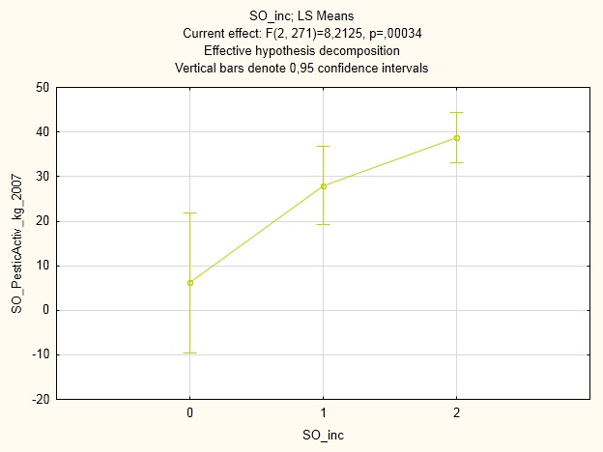
Joint operation agreement: use of pesticides - Municipalities that do better do not apply FOR subsidies…
Joint operation agreement:
Municipalities perform a large number of actions w.r.t. environment
They choose the level of participation: no participation / basis / understanding
Example of the use of pesticides:
Evolution from 2004 → 2010: significant reduction
But:
Not participating municipalities did significantly better than participating municipalities (2004 / 2007)
Participating municipalities reduced more (but not significantly)
X
X
X
No partic.
Basis
Understanding

Slide 11
Conclusions on effectiveness: few proven relations between outcome and subsidy attribution
☺
Duurzaamheidsambtenaar
Mobiliteit
Bosbeheerplan
Totale hoeveelheid afval
Hinder
Water (pesticiden)
Sonometers
😐
Hoeveelheid restafval
Groenjobs / Mina-werkers
Water (pesticiden)
Erosie
Riolering
HPG
Bebossing
Landinrichting
Natuur
Sonometers
☹
Ecologisch bosbeheer
Hinder
Zwerfvuil
Output
Impact
Outcome

Slide 12
Deeper study of the 3 most important subsidies: waste, sewerage, support of the local policy
Methodology:
Interview with subsidy supplier
Focusgroups with municipalities
Research questions:
Is the observed evolution due to or in spite of the subsidy?
What are the most important factors influencing the results?
Which sticking points do the municipalities encounter?
Etc.

Slide 13
All results have been summarised in the SWOT matrix
Positive aspects
Negative aspects
Acceleration of the investments
Guaranteed quality of measures
More own control
Low (proved) effectiveness
Improvable efficiency
No overall vision on how to finance municipalities
Difficulties with procedures
.......
Internal aspects
S
W
Intention to coordinate to a higher extent all policy processes (6 years)
T
O
Savings
External aspects

Slide 14
Structure of the general recommendations to the flemish environmental department
Measure / action
Legally obliged?
no
Total cost-recovery possible (polluter pays principle)?
No subsidy
yes
no
yes
No subsidy
Contributes to priority objectives (Flanders)?
no
No subsidy
Possibly:
Other types of financing (e.g. if cost between municipalities is very different)
Subsidy for the transitional period
...
yes
Applicable within planning cycle?
no
Specific subsidy
yes
One-off investments
Subsidy

