Slide 1
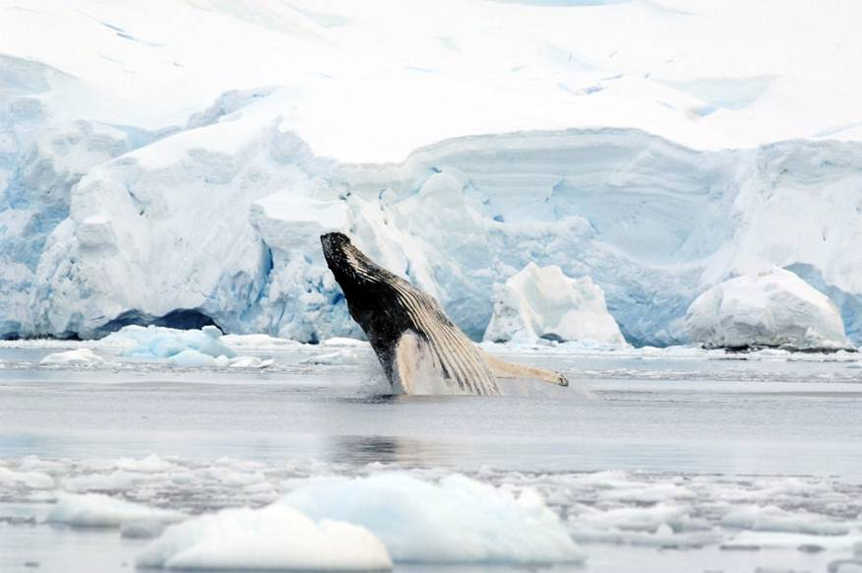
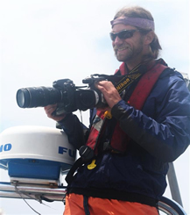
Complexity and Cold Photography in Antarctica
Complexity can be found wherever it is sought. Ecological relationships and environmental structure are bound together in ways that seemingly run the gamut from simple to complex. However, the more we study ecosystems and the relationship between organisms and their environment, the more complex nature seems to be.
Every person that visits Antarctica is touched by the place. One also becomes aware of the threats that face this wilderness, and that despite its rough and impenetrable exterior, it is fragile and in need of protection. As scientists, our goals are to learn about these threats, what can be done to thwart them, and communicate this knowledge with others.
Antarctica is a fantastically harsh environment. Life exists on a knife-edge dictated by the advance and retreat of sea ice, the complete explosion of sun-powered life in the summer, and the desolation of utter darkness in winter. Viewed from space, the annual growth and decay of sea ice around Antarctica is one of the most visible and simple natural phenomena found on our planet. However, understanding how changes and modification in the timing and amount of sea ice affect the Antarctic marine ecosystem, that has evolved to be ice-dependent, are extremely complex. The simple phase change from water to ice is rooted in a recipe of temperatures, winds and currents that we still do not fully understand.
Every person that visits Antarctica is touched by the place. One also becomes aware of the threats that face this wilderness, and that despite its rough and impenetrable exterior, it is fragile and in need of protection. As scientists, our goals are to learn about these threats, what can be done to thwart them, and communicate this knowledge with others.
The images presented here represent features of and glimpses into the Antarctic. The places, the colors, the shapes, and the animals are linked. As scientists, gaining focus and lucidity about complex and changing ecosystems is paramount to being able to predict and mitigate how human actions affect our planet.
Enjoy and think.
The staple of the Antarctic marine ecosystem, Antarctic krill, is the most ubiquitous organism in the Southern Ocean. While we know that krill require sea ice to survive and reproduce, we still do not understand the intricate interactions between sea ice, nutrients, and predators that, in concert, dictate the survivability of Antarctic krill. And while we know that penguins, seals, seabirds, and whales all rely on Antarctic krill, we know little about the interactions between these species and how the availability of krill affect how different species grow and survive.
My research focuses on the foraging ecology and effects of climate change of marine mammals. I am involved in several projects tagging marine mammals (including humpback, minke, pilot, and beaked whales) in a range of environments from Antarctica to the tropics to study how their behaviors relate to environmental variables including their prey. We use a suite of geospatial analysis tools and emerging technology to visualize and analyze the movement patterns and behaviors of these whales underwater. -- Ari is an Assistant Research Scientist at Duke University and a professional photographer. He resides in Beaufort, NC.
Ari S. Friedlaender
As the Antarctic Peninsula warms at a faster rate than any other place on our planet, it is imperative to unravel the interactions between climate and oceans that are manifesting in dramatic changes throughout the Antarctic marine ecosystem.

