Slide 1
Building Evaluation Capacity in A Complex Environment:
The Chesapeake Bay Partnership’s Experience with Evaluation, Adaptive Management and Accountability
Presentation by Michael Mason
Evaluation and Accountability Team Leader
Office of Water
U. S. EPA
June 24th, 2011
Notes:
Michael Mason
Evaluation and Accountability Team Leader
Office of Water
U. S. EPA
When I heard that the Forum theme was going to be “navigating complexity,” I thought, boy, do I have a situation for you. The Chesapeake Bay is an excellent case study in an attempt to build an evaluation capacity in a complex environment - scientific, social, and political.

Slide 2
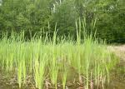
Topics to be Covered
Chesapeake Bay Partnership 101
  A Little History
  The TMDL and its Implementation
  Executive Order, Strategy & Implementation
The Turning Point
Evaluation, Adaptive Management, and Accountability
  Searching for An Independent Evaluator
  Launching An Adaptive Management Approach
  What Do We Mean By Accountability in A Partnership?
Notes:
The purpose of my presentation is twofold:
To provide some background on the history, players, and programmatic and political issues surrounding the Chesapeake Bay Partnership
To discuss my observations on recent efforts by the Bay Partnership to develop a program evaluation and adaptive management capability
This will be useful background for the Afternoon session at 3:30 with a panel of experts. If you show up you are ahead of the game.
Topics I plan to cover:
Chesapeake Bay Program 101
The Problem Identified
Executive Order Strategy & CBP Alignment
The TMDL and its Implementation
II. The Turning Point
III. Evaluation, Adaptive Management, and Accountability
Searching for An Independent Evaluator
Launching An Adaptive Management Approach
What Do We Mean By Accountability in A Partnership?
Questions and turn it over to Doreen. Ok, let’s fly

Slide 3
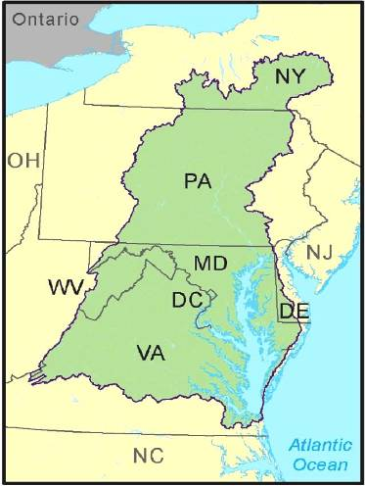
I.A Chesapeake Bay 101
Largest U.S. estuary
Six-states and DC, 64,000 square mile watershed
10,000 miles of shoreline (longer then entire U.S. west coast)
Over 3,600 species of plants, fish and other animals
Average depth: 21 feet
$750 million contribution annually to local economies
Home to 17 million people (and counting)
77,000 principally family farms
Declared “national treasure” by President Obama
3
Source: www.chesapeakebay.net
Notes:
How many people in the room live in the Washington DC area?
Largest U.S. estuary
Six-states and DC, 64,000 square mile watershed
10,000 miles of shoreline (longer then entire U.S. west coast)
Over 3,600 species of plants, fish and other animals
Average depth: 21 feet
$750 million contribution annually to local economies
Home to 17 million people (and counting)
77,000 principally family farms
Declared “national treasure” by President Obama

Slide 4

Summary: 2008 Bay Health Assessment
Restored Bay
Priority Areas
Water Quality
21%
of
Goals Achieved
Habitats & Lower Food Web
45%
of
Goals Achieved
Not quantified in relation to a goal
Fish & Shellfish
48%
of
Goals Achieved
Not quantified in relation to a goal
Data and Methods: www.chesapeakebay.net/status_bayhealth.aspx
4
Notes:
Chesapeake Bay is at a crossroads, with its future health still at stake. For 20 years, restoration efforts have been underway to reverse the decline of the Bay ’s health, but the cumulative impact of centuries of population growth (currently 16 million) and landscape changes has taken its toll.
Health Assessment Summary:
Water Quality – Most of the Bay’s waters are degraded—less than one-third of Bay water quality goals are being met.. Each summer, a large expanse of its waters does not hold enough oxygen to support striped bass (rockfish), crabs and oysters. Algal blooms fed by nutrient pollution block sunlight from reaching the underwater bay grasses needed to support aquatic life. Sediment from urban development and agricultural lands is carried into the Bay, clouding its waters and covering critical oyster reef habitat. Currently, about one-third of Bay water quality goals are being met.
Habitats and Lower Food Web – The Bay’s critical habitats and food webs are at risk at about a third of desired levels.. Nutrient and sediment runoff have harmed bay grasses and bottom habitat. Excessive algae growth has pushed the Bay food web out of balance. A large portion of the Bay’s wetlands has been lost to development. Currently, the Bay’s habitats and lower food web are at about a third of desired levels.
Fish and Shellfish - Many of the Bay’s fish and shellfish populations are below historic levels. The number of adult blue crabs is below the long-term average for the seventh straight year and oyster populations are at or near historic lows. American Shad are recovering slowly, while other species like striped bass (rockfish) show mixed signals. Current rockfish populations exceed restoration goals, but approximately 60 to 70 percent are infected by a disease called mycobacteriosis. Researchers are currently working to understand the extent and severity of the disease and the extent to which environmental conditions in the Bay influence it. As ecosystem-based goals are not yet developed for fish and shellfish species, data are not averaged in this section this year.

Slide 5
I.A. A Little History
Bay has been a model of collaboration and partnership and coordination with a focus on consensus building
  Chesapeake Bay Program established in 1983
  1987 Chesapeake Bay Agreement
  2000 Chesapeake Bay Agreement (C2K)
Bay Program has always been data rich with strong science and research programs
But Bay was not getting cleaner and goals from previous agreements were not met
  Multiple studies and audits in 2005-2007 timeframe (GAO, EPA IG, CBF)
CBPO Report to Congress issued July 2008 (CAP)
Notes:
The Chesapeake Bay Program, a unique voluntary partnership, is established in1983 with the signing of the first Chesapeake Bay Agreement by Maryland, Pennsylvania, Virginia, the District of Columbia, the Chesapeake Bay Commission and the EPA. The agreement establishes the Chesapeake Executive Council as the Bay Program's chief policy-making authority. The Chesapeake Bay was the first estuary in the nation to be targeted for restoration as an integrated watershed and ecosystem.
The 1987 Chesapeake Bay Agreement is signed by Bay Program partners. The 1987 Agreement sets a goal to reduce nitrogen and phosphorus entering the Bay by 40 percent by the year 2000. It also directs the Bay Program to study atmospheric inputs to the Bay.
Chesapeake 2000 sets a goal to reduce nutrient and sediment pollution enough to remove the Bay and its tidal rivers from the EPA's “impaired” water body listing by 2010. The agreement details over 100 commitments and actions necessary restore the health of the Bay and its living resources.
2008 The Bay Program submits a report to Congress outlining new strategies to increase accountability and strengthen the management of the Bay Program. Strengthening Management, Coordination and Accountability (CAP)

Slide 6
I.A. A Little History
EPA sued by CBF to develop a Total Maximum Daily Load (“pollution diet”) to hold states accountable for water quality goals for nutrient and sediments.
  EPA issues Bay Total Maximum Daily Load (TMDL) in December 2010
  Load allocation established with goal of 60% of WQ criteria met in Basin by 2025
President issues Executive Order on the Bay in May 2009
  E.O. resulted in new federal mandates and enhanced role of federal partners on top of traditionally state partnership/voluntary effort
6
Notes:
6/24/2011
6
EPA sued by CBF to develop a Total Maximum Daily Load (“pollution diet”) to hold states accountable for water quality goals for nutrient and sediments.
EPA issues Bay Total Maximum Daily Load (TMDL) in December 2010
Load allocation established with goal of 60% of WQ criteria met in Basin by 2025
President Barack Obama signs an Executive Order calling on the federal government to lead the effort to control pollution and protect wildlife habitats in the Chesapeake Bay region.
President Barack Obama signs an Executive Order calling on the federal government to lead the effort to control pollution and protect wildlife habitats in the Chesapeake Bay region.

Slide 7
II.B. Chesapeake Bay TMDL
TMDL will establish a ‘pollution budget’ for nitrogen, phosphorus, & sediment
EPA/states set the major river basin loading caps
States set geographic- and source-specific loading caps in their Watershed Implementation Plans
EPA establishes the TMDL
Notes:
TMDL will establish a ‘pollution budget’ for nitrogen, phosphorus, & sediment
EPA/states set the major river basin loading caps
States set geographic- and source-specific loading caps in their Watershed Implementation Plans
EPA establishes the TMDL
The Bay TMDL will be the largest and most complex ever developed, involving pollution sources throughout a 64,000-square-mile watershed that includes six states and the District of Columbia.
- A TMDL is the calculation of the maximum amount of pollution a body of water can receive and still meet state water quality standards designed to ensure waterways are safe, swimmable and fishable.
- The Clean Water Act requires that a TMDL be written for all segments of a waterway that fail to meet water quality standards. Most of the Chesapeake Bay and its tidal waters do not meet the standards and are listed as impaired.
- Monitoring data continues to show that the Bay has poor water quality, degraded habitats and low populations of many species of fish and shellfish. The Bay and its rivers are overweight with nitrogen, phosphorus and sediment from agricultural operations, urban and suburban runoff, wastewater, airborne contaminants and other sources.
- The Bay TMDL – actually a combination of 92 smaller TMDLs for individual Chesapeake Bay tidal segments – will include pollution limits that are sufficient to meet state standards for dissolved oxygen, water clarity and chlorophyll-a, an indicator of algae levels.

Slide 8
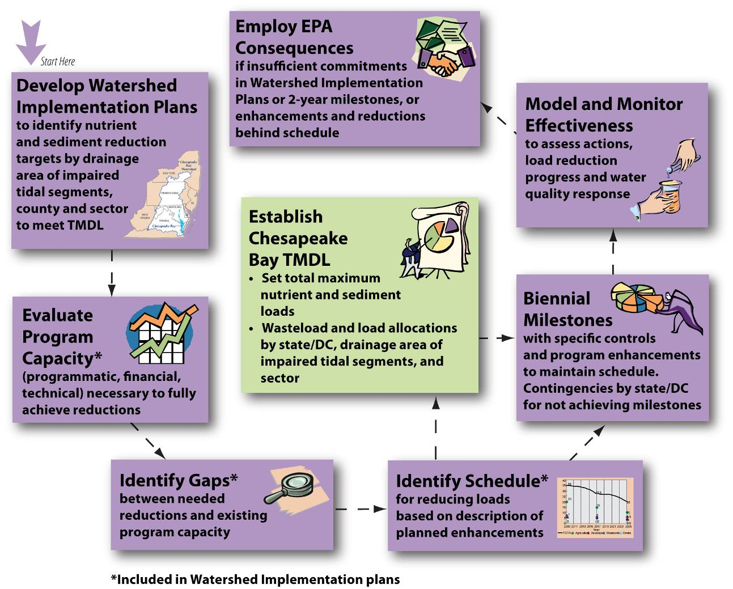
I.B. Overview of TMDL Accountability Process
Federal Actions
Watershed
Implementation
if insufficient Watershed Implementation Plans or 2-year milestones
Model and Monitor
Plans identify
to assess progress
nutrient and sediment targets that meet water quality standards. Plans include:
Chesapeake Bay TMDL: Set Pollution Reduction Goals for Point and Non-point Sources to Meet Bay Water Quality Standards
2-Year
1. Evaluation of Program Capacity
Milestones
with program enhancements and nutrient and sediment reduction commitments
necessary to fully restore water quality
2. Identification of
Gaps between
3. Schedule and
Strategies
needed and existing program capacity
to enhance programs and
reduce nutrients and sediment

Slide 9
I.C. Executive Order, Strategy, and Implementation
May 12, 2009 – President Obama issued Executive Order 13508 for the Protection and Restoration of the Chesapeake Bay
  Establishes Federal Leadership Committee (FLC)
  Charges federal agencies with developing a Strategy to initiate bold new actions and make dramatic policy changes
  Requires FLC to “publish an annual Chesapeake Bay Action Plan describing how Federal funding will be used to protect and restore the Chesapeake Bay.” To be followed by an Annual Progress Report
  Establish an Independent Evaluator supported by an adaptive management system to periodically report on progress in meeting goals of Order
May 12, 2010 – Federal agencies release Strategy for Protecting and Restoring the Chesapeake Bay Watershed
  Includes four goal areas
  Twelve outcome measures
September 30, 2010 – Federal agencies release Fiscal Year 2011 Action Plan
  Demonstrates federal government leadership and taking responsibility for progress
  Total FY2011 federal funding: $490,550,424
  Based on resources directly attributable to Chesapeake strategy
Notes:
May 12, 2009 – President Obama issued Executive Order 13508 for the Protection and Restoration of the Chesapeake Bay
Establishes Federal Leadership Committee (FLC)
Charges federal agencies with developing a Strategy to initiate bold new actions and make dramatic policy changes
Requires FLC to “publish an annual Chesapeake Bay Action Plan describing how Federal funding proposed in the President’s Budget will be used to protect and restore the Chesapeake Bay during the upcoming fiscal year.” To be followed by an Annual Progress Report
Establish an Independent Evaluator supported by an adaptive management system to periodically report on progress in meeting goals of Order
May 12, 2010 – Federal agencies release Strategy for Protecting and Restoring the Chesapeake Bay Watershed
Includes four goal areas
Twelve outcome measures
September 30, 2010 – Federal agencies release Fiscal Year 2011 Action Plan
Demonstrates federal government leadership and taking responsibility for progress
Total FY2011 federal funding: $490,550,424
Based on resources directly attributable to Chesapeake strategy

Slide 10
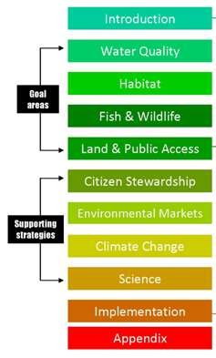
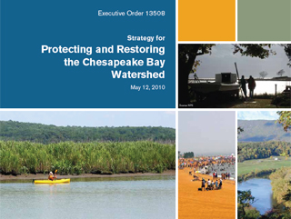
II.A. Executive Order Strategy Implementation & Alignment
Notes:
Four goals areas:
Water quality
Habitat
Fish and Wildlife
Land and Public Access
Supporting Strategies
Implementation Chapter on Evaluation Adaptive Management
Annual Progress Reports
Required by EO, Progress reports will:
Review indicators of environmental conditions in the Chesapeake Bay,
Assess implementation of the Action Plan during the preceding fiscal year
Recommend steps to improve progress
First annual progress report due early in 2012
- Will help assess the success of the agencies’ efforts in implementing the actions identified in the preceding action plan
Provides agencies with a regular opportunity to adjust implementation efforts

Slide 11
CBP Organizational Structure and Leadership 6-08-11
Citizens’ Advisory
Committee
Chair - Jim Elliot
Hunton & Williams LLP
Independent
Evaluator
Chesapeake Executive Council
Chair – Lisa Jackson, EPA
Principals’ Staff Committee
Chair – Shawn Garvin, EPA
Local Government
Advisory Committee
Chair – Mary Ann Lisanti
Harford County
Action Teams
Independent Evaluator
Chair – Horan, MdDNR
EC/FLC Alignment
Chair – Bisland, EPA
ChesapeakeStat/Adptv. Mgt.
Co-Chair – Stewart, MdDNR
Co-Chair – Muller, USNA
Management Board
Acting Chair
Jim Edward, EPA
Scientific & Technical
Advisory Committee
Chair – Denise Wardrop
PSU
Communications
Workgroup
Chair-Riggs, DeDNREC
Vice-Stoltzfus, MDE
Goal Implementation Teams
Science,
Technical Analysis,
and Reporting
Sustainable
Fisheries
Protect & Restore
Vital Habitats
Protect &
Restore Water
Quality
Maintain
Healthy
Watersheds
Foster
Chesapeake
Stewardship
Partnering,
Leadership
& Management
Dennison
UMd
Bennett
USGS
Tango
USGS
Barnes/Gorka
CRC
Chair
ViceChair
Cdtr
Staff
Robertson
NOAA
O’Connell
MdDNR
Vogt
NOAA
Davis
CRC
Miranda
  USFWS
Horan
MdDNR
Greiner
  USFWS
Hession
  CRC
Merrill
EPA
Perkinson
VaDCR
Antos
EPA
Streusand/Kilbert
CRC
Bryer
NGO(TNC)
Hall
MdDP
Fritz
EPA
Burnett
CRC
Maounis
NPS
Barrett
PaDCNR
Handen
NPS
Brzezinski
CRC
Foreman
VaDCR
Bisland
EPA
Allen
EPA
Wilke
CRC
Implementation
Workgroups
Implementation
Workgroups
Implementation
Workgroups
Implementation
Workgroups
Implementation
Workgroups
Implementation
Workgroups
Notes:
11

Slide 12
II. The Turning Point or Nature of the Current (Political) Environment
Bay Partnership is at a key turning point.
  Bay Partnership is going through a period of transition from collaborative partnership to a regulatory, top-down approach
End of C2K, focus on TMDL, and E.O has resulted in heightened tension and confusion within the partnership
  There is a disagreement between Feds and states on goals/outcomes for the Bay
  Tension between federal ecosystem-based approach and state water quality-focused effort
  Non-water quality Goal Teams appear to be floundering with confusion about their roles, relevance, and responsibilities within partnership
  Resulted in some gaps & misalignment within the Bay organizational structure
12
Notes:
6/24/2011
12
Program is at a key turning point.
Bay Partnership is going through a period of transition from collaborative partnership to a regulatory, top-down approach
End of C2K, focus on TMDL, and E.O has resulted in heightened tension and confusion within the partnership
There is a disagreement between Feds and states on goals/outcomes for the Bay
Non-water quality Goal Teams appear to be floundering with confusion about their role, relevance, and relationship to the MB
Tension bertween Collaborative partnership vs. regulatory approach
GITs (except 3) appear to be floundering with confusion about their role, relevance, and relationship to the MB
- Resulted in some gaps & misalignment within the Bay organizational structure

Slide 13
II. The Turning Point or the Nature of the Current (Political) Environment
Most Bay partners are supportive of E.O. and the Strategy but are confused about its role and concerned about its impact
  Fear it will upset long standing federal-state Bay relationships
  Ambiguity of who is in charge: C2K goals or EO goals? What is the controlling document?
Focus on water quality, TMDL, and Watershed Implementation Plans (WIPs) is dominating states’ attention and is driving funding, prioritization, & Bay Program organizational relationships
  State partners are afraid of unfunded mandates and too much federal representation
On a bad day, CBP can appear to be a “den of grievances”
  Goal Teams vs Management Board
  Urban (point sources) vs agriculture (nonpoint)
  Headwaters vs Tidal/Bay states
  Water quality vs non-water quality partners
  States vs Feds
  Republican vs Democrats
Notes:
Most respondents are supportive of E.O. Strategy but are confused about its role and concerned about its impact
States weren’t significantly involved in development of Strategy so haven’t committed to outcomes (“Strategy is by the feds, for the feds”) But Strategy can’t be achieved without state engagement and participation
States welcome federal involvement but don’t feel accountable to goals. Fear it will upset long standing federal-state Bay relationships
- C2K has run its course: elephant in the room. Strategy could be the basis for the new Agreement
Focus on water quality, TMDL, and WIPs is dominating states’ attention and is driving funding, prioritization, & Bay Program organizational relationships.
On a bad day, CBP is den of grievences
GITs vs MB
States vs Feds
Headwaters vs Tidal/Bay states
Urban (point) vs agriculture (non-point sources)
Water quality vs non-water quality
Republican vs Democrats

Slide 14
III.A. Program Evaluation and the Chesapeake Bay
Origin of the Independent Evaluator (IE)
  2005 - U.S. GAO Report recommendation to establish an independent and objective reporting process
  2007 - U.S. GAO Report on need for integrated implementation plan
  2008 - Executive Council established Independent Evaluator Action Team to report to the Management Board
  2009 - Executive Order 13508 calls for independent evaluator to periodically evaluate protection and restoration activities
  2009 – National Academy of Science study begins as evaluation pilot
  2011 – NAS study published
Notes:
What was impact of this complexity on efforts to develop an evaluation capability and adaptive management system?
Origin of the Independent Evaluator
2005 - U.S. GAO Report recommendation to establish an independent and objective reporting process
2007 - U.S. GAO Report on need for integrated implementation plan
2008 - Executive Council established Independent Evaluator Action Team to report to the Management Board
2009 - Executive Order 13508 calls for independent evaluator to periodically evaluate protection and restoration activities
2009 – National Academy of Science study begins as evaluation pilot
2011 – NAS study published

Slide 15
III. A. Program Evaluation and the Chesapeake Bay
Why was an independent evaluator (IE) necessary for the Bay?
  Bay Program had lost the trust of Congress and the enviro groups on acknowledging the extent of the water quality problem and the ability to fix it.
  Concern from citizens about lack of verification for state and local actions to address water quality
History of IE has been one of foot dragging and fear about loss of control
  There has been some confusion about the appropriate location of the IE, its focus, and cost.
Bay Program launched a pilot with National Academy of Science (NAS) in 2009.
  NAS conducted 2 year study on nutrients.
What are the lessons learned from the NAS evaluation pilot?
  Was this really an evaluation?
  Was it independent?
  Was it useful?
  Is CBP living up its mandate to establish an independent evaluator?
CBP is still debating the role of the IE
Notes:
Why was an independent evaluator necessary for the Bay?
Bay Program had lost the trust of Congress and the enviro groups on acknowledging the extent of the water quality problem and the ability to fix it.
Concern from citizens about lack of verification for state and local actions to address water quality
History of IE has been one of foot dragging and fear about loss of control
There has been some confusion about the appropriate location of the IE, its focus, and cost.
Bay Program launched a pilot with National Academy of Science (NAS) in 2009.
NAS conducted 2 year study on nutrients
What are the lessons learned from the NAS evaluation pilot?
Was this really an evaluation?
Was it independent? Bay selected the questions.
Was it useful? TMDL was completed before the study was done.
Is CBP living up its mandate to establish an independent evaluator?
CBP is still debating the role of the IE

Slide 16
III.A. Program Evaluation and the Chesapeake Bay
The Independent Evaluator should focus on WIP implementation and federal and state milestones.
  Options for future evaluations would result from milestone reviews and annual watershed model progress runs for TMDL
The Bay Program should develop an internal program evaluation function to conduct assessments on implementation and management issues.
  What’s working, not working, & why
Notes:
The Independent Evaluator should focus on WIP implementation and federal and state milestones.
- Options for future evaluations would result from milestone reviews and annual watershed model progress runs for TMDL
The Bay Program should develop an internal program evaluation function to conduct assessments on implementation and management issues.
- This would include a trouble shooting function to fix implementation problems within the GITs.
- Location could be part of GIT 6 or a separate entity that reports to the MB.
GIT 6 should play a more active role in supporting the management of the GITs and the Management Board.
- Annual management and needs assessments of the GITs
- Provide technical assistance and training

Slide 17
III.B. Ches. Bay Program Commitment to Adaptive Management
2005 – GAO Report recommendation to develop coordinated implementation plan and target resources
2008 - Chesapeake Action Plan – Report to Congress
2009 - Executive Order 13508 section 203 (e)
2010 – Federal Strategy for Protecting and Restoring Bay Watershed
2010 Proposed Legislation
Chesapeake Bay Governance Document
Notes:
2005 – GAO Report recommendation to develop coordinated implementation plan and target resoures
2008 - Chesapeake Action Plan – Report to Congress
- expressed intent to institute adaptive management to enhance overall management
- proposed Kaplan and Norton (2008) 5 stage model
2009 Executive Order 13508 section 203 (e)
- “develop a process for implementing adaptive management principles with periodic evaluation of protection and restoration activities
- Executive Order report 202(f) recommended adaptive management ecosystem framework (William and Levin [see chart?]
2010 – Federal Strategy for Protecting and Restoring Bay Watershed
- Promoted “ecosystem-based, adaptive management through enhanced coordination of science and decision-support activities
Executive Order report 202(f)
Proposed Legislation (Wittman Bill)
Chesapeake Bay Governance Document

Slide 18
CBP Adaptive Management Program-Level System
Management System Review
Revision of Strategy
Coordinated Implementation Strategy
Evaluation of Ecosystem Response and Organizational Performance
Annual Action Plan
Action Plan Development
Quarterly Review of Progress and Short-Term Adjustments
Execute programs and initiatives
Notes:
Kaplan and Norton (2008) 5 stage model from Harvard Business Review article

Slide 19
III.B. Adaptive Management and the Chesapeake Bay
Partners held off on developing an adaptive management system due to the E.O., Strategy development, and TMDL
  Lack of alignment over goals and reporting and organization put adaptive management on hold until issues could be resolved.
CBP partners became more confused about how multiple planning and reporting requirements from EO and TMDL fit together
  What does the information mean and how should it be used
Problem was how to build an AMS within a politically and organizationally fluid environment.
Alignment issues are still unresolved but the Bay program is going ahead with AM.
Created Decision Framework in 2011.
19
Notes:
6/24/2011
19
Partners held off on developing an adaptive management system due to the E.O., Strategy development, and TMDL
Lack of alignment over goals and reporting and organization put adaptive management on hold until issues could be resolved.
CBP partners became more confused about how multiple planning and reporting requirements from EO and TMDL fit together
What does the information mean and how should it be used
Problem was how to build an AMS within a politically and organizationally fluid environment.
Alignment issues are still unresolved but the Bay program is going ahead with AM.
Created Decision Framework in 2010.
Need healthy balance between adaptive management & accountability
Federal partners shouldn’t just hold states accountable. Rather, they should focus on assisting those who fail to meet their targets or fall behind on targets. Planning and evaluation should include focus on program improvement and problem solving.

Slide 20
III.B. Chesapeake Bay Decision Framework
Articulate program goals.
Describe factors influencing goal attainment.
Assess current management efforts (and gaps).
Develop/Revise management strategy.
Develop/Adjust monitoring program.
Assess performance.
Manage adaptively.
20
Notes:
1. Articulate program goals.
e.g., Conserve healthy watersheds in a variety of landscapes (e.g., agricultural, residential, etc.).
2. Describe factors influencing goal attainment.
e.g., Local knowledge of effective management practices to conserve “health.”
3. Assess current management efforts (and gaps).
e.g., Need effective transfer of successful practices between localities.
4. Develop management strategy.
e.g., Establish information sharing web forum and peer mentoring network.
5. Develop monitoring program.
e.g., Document local implementation of ideas drawn from other watersheds.
6. Assess performance.
e.g., Greater than desired number of local implementations.
7. Manage adaptively.
e.g., Review value of information sharing strategy and revise if needed
6/24/2011
20

Slide 21
III.B. Adaptive Management and the Chesapeake Bay
Current approach to implementing Decision Framework is to start small – focus on a few Goal teams – and gradually work from the bottom up within the organization
Take an incremental step to improving coordination and supporting the ability of the Management Board to:
  review performance,
  make informed agreements about resource allocation,
  identify opportunities for strategic coordination and leveraging of complementary efforts, and
  recognize when program redirection is necessary.
This process will also inform other partners and the public about CBP priorities and progress toward achieving those priorities.
  ChesapeakeStat tool will be used as platform to facilitate AM
Bay Partnership has the organizational structure to build an effective AM system
  It has the data, science, and modeling capability
  It needs to start where it is, use what it has, and go forward on an iterative basis.
  In other words, take an adaptive approach...
Notes:
Current approach to implementing Decision Framework is to start small – focus on a few Goal teams – and gradually work from the bottom up within the organization
Implement with flexible approach by filling out Decision Framework with interested GITs (Habitat, WQ – Agriculture, Watersheds).
Take an incremental step to improving coordination and supporting the ability of the Management Board to:
review performance,
make informed agreements about resource allocation,
identify opportunities for strategic coordination and leveraging of complementary efforts, and
recognize when program redirection is necessary.
This process will also inform other partners and the public about CBP priorities and progress toward achieving those priorities.
ChesapeakeStat tool will be used as platform to facilitate AM
Bay Partnership has the organizational structure to build an effective AM system
It has the data, science, and modeling capability
It needs to start where it is, use what it has, and go forward on an iterative basis.
In other words, take an adaptive approach...

Slide 22
III.B. Adaptive Management and the Chesapeake Bay
NAS Conclusions on Bay Partnership’s Approach to Adaptive Management for Improving Water Quality
  Neither EPA nor Bay jurisdictions exhibit clear understanding of adaptive management and how it might be applied
  EPA and Bay jurisdictions have not fully analyzed uncertainties inherent in nutrient and sediment reduction efforts and water quality outcomes
  Targeted monitoring efforts by states and the CBP will be required to support adaptive management
  The TMDL accountability framework and threatened consequences for failure will dampen Bay’s jurisdictions’ enthusiasm for adaptive management.
  Without sufficient flexibility of the regulatory and organizational structure, adaptive management may be problematic
22
Notes:
6/24/2011
22
NAS Conclusions on Bay Partnership Approach to Adaptive Management for Improving Water Quality
Neither EPA nor Bay jurisdictions exhibit clear understanding of adaptive management and how it might be applied
EPA and Bay jurisdictions have not fully analyzed uncertainties inherent in nutrient and sediment reduction efforts and water quality outcomes
CBP models
Ecological processes
Water quality impacts of reduced nutrient loads
Realization of anticipated nutrient load reductions
Willingness and ability to implement nutrient controls
Political will and multijuridictional cooperations
Targeted monitoring efforts by states and the CBP will be required to support adaptive management
Need better integration of modeling and monitoring
Monitoring not modeled for AM
The TMDL accountability framework and threatened consequences for failure will dampen Bay’s jurisdictions’ enthusiasm for adaptive management.
- Failures should not be penalized
Without sufficient flexibility of the regulatory and organizational structure, adaptive management may be problematic
TMDL, load allocations, WQ criteria may need to be modified
-TMDL is a process and not an endpoint

Slide 23
III.C. Accountability and the Chesapeake Bay
The meaning of accountability is unclear
  External vs internal (public vs partner-partner)
  Regulatory vs voluntary agreements
  Increase vs reduction in funds with grant conditions
All partners could be held accountable through the budgeting process (implementation grants).
States could also be held accountable through WIPs, milestones and TMDL for water quality goals and MOUs for non-water quality goals.
Individual partners should be held accountable for actions they can actually control, rather than long-term environmental outcomes.
There needs to be transparency and verification of data.
Partners need to properly manage the public’s expectations, or will lose the public’s trust.
Notes:
1. The meaning of accountability is unclear
External vs internal (public vs partner-partner)
Regulatory vs voluntary agreements
Increase vs reduction in funds with grant conditions
2. All partners could be held accountable through the budgeting process (EPA & implementation grants: OMB and fed budget).
There is no legal or regulatory mechanism for the federal government to be held accountable to the E.O. [federal and “other” response]
3. States could also be held accountable through WIPs, milestones and TMDL for water quality goals and MOUs for non-water quality goals.
4 Partners should be held accountable for actions they can actually control, rather than long-term environmental outcomes.
5 There needs to be transparency and confirmation of data.
- Provide more data up front on the goal and indicator parameters. Directly under every data chart, the following information should be provided: What is the actual numeric goal or target? What is the target year goal will be met? When was the goal set? Currently, most charts just indicate percentages of goal met. This is fine for assessing trends but it is not enough information to assess accountability.
6 Partners need to properly manage the public’s expectations, or else they will lose the public’s trust and respect.
Federal partners shouldn’t just hold states accountable. Rather, they should focus on assisting those who fail to meet their targets or fall behind on targets. Planning and evaluation should include focus on program improvement and problem solving.

Slide 24
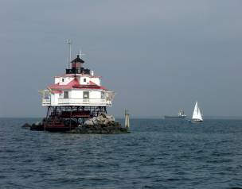
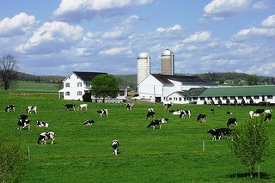

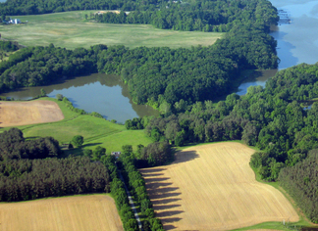
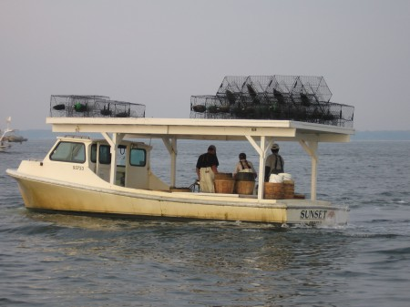
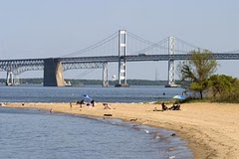
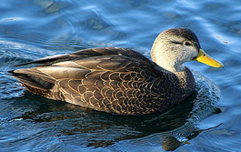
QUESTIONS AND COMMENTS
http://executiveorder.chesapeakebay.net/

Slide 25
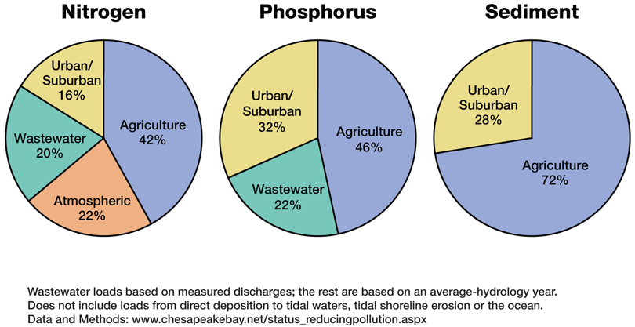
II.C. Pollutant Sources to the Bay
Notes:
Nutrient and Sediment Loads by Sector

Slide 26
II.C. Nutrient Loads by State
Nitrogen*
Phosphorus
*EPA estimates a nitrogen load of 284 million lbs nitrogen in 2008. EPA assumes a reduction of 7 million lbs due to the Clean Air Act. This leaves 77 millions lbs to be addressed through the TMDL process.
26

Slide 27
CBP GIT Implementation Workgroup Structure 06-08-11
Goal Implementation Teams
Sustainable
Fisheries
Protect & Restore
Vital Habitats
Protect &
Restore Water
Quality
Maintain
Healthy
Watersheds
Foster
Chesapeake
Stewardship
Enhance
Partnering,
Leadership
& Management
Ches. Bay
Stock Assessment Committee
Fish Passage Workgroup
Agriculture Workgroup
Watershed Health Workgroup
Chesapeake Conservation Corps Action Team
IT Infrastructure Workgroup
Stream Habitat Workgroup
Forestry Workgroup
Budget and Assistance Coordination Workgroup
Land Use Planning Workgroup
Education Workgroup
Fisheries Ecosystem Workgroup
Submerged Aquatic Vegetation Workgroup
Reevaluation Technical Workgroup
Land ConservationWorkgroup
Master Watershed Steward Action Team
Single Species Teams
Sediment Workgroup
Wetlands Evaluation Workgroup
Urban Stormwater Workgroup
Public Access Planning Action Team
Quantitative Ecosystem Teams
Wastewater Treatment Workgroup
GIS Land Conservation Priority System Team
Watershed Technical Workgroup

Slide 28

TMDL and WIP Development Schedule: 2009-2017
Major basin
jurisdiction
loading
targets
Final WIPs
November-December 2010
Oct 2009
Final
TMDL
Established
November-December 2009
Bay TMDL Public Meetings
December 2010
Phase II Watershed Implementation Plans: Starting 2011
Provide Local Planning Targets for smaller Watersheds,
Counties,
Sources
Draft Phase I Watershed Implementation Plans: November 2009 – Sept.1 2010
Local Program Capacity/Gap Evaluation
2-year
milestones, reporting, modeling, monitoring
July 1 and August 13 Allocations
Starting 2011
Draft TMDL
Sept. 24, 2010
(45 days)
Public
Review
And
Comment
2017 60% of Practices in Place - Phase III WIPs to meet 2025 Goal
28
Notes:
6/24/2011
28

Slide 29
29
29

Slide 30
Example: Projected Nitrogen Delivery from
Major Basin in Each Jurisdiction by Source Sector
Propose new legislative authorities
Implement regulatory controls
Propose increased budget to legislature
Increased program budget
Examples of Some Planned Controls
Rulemaking
Increased controls
35
26
Load Reduction
Schedule
20
Interim
Targets
Final
Targets
Milestones for Assessing Progress
Stage 1 Implementation
Stage 2 Implementation
Also divide jurisdiction load by 303(d) segment drainage area and, by November 2011, local area
Attain jurisdiction-wide load reductions by the interim target, or justify why can still meet final target
Jurisdiction would determine desired 2-year schedule to meet interim and final target loads
EPA first evaluates milestones based on consistency with jurisdiction target load. EPA accepts shifts among source sectors, basins, segment drainages, and local areas if jurisdiction target load is met and local and Bay water quality goals are achieved

Slide 31
II.C. Development of TMDL Tracking System - BayTAS Version 1.0
Required by Executive Order Strategy & EPA-CBF Settlement Agreement
  Begin to use the system by Jan 2011
Track TMDLs for 92 Segments in Bay Watershed
  Track WLAs for NPDES Point Sources; Track LAs for Non-Point Sources/Sectors; Track Practices reported in WIPS
Are States on target to achieve the Bay TMDL?
  Are WLAs being achieved? Are LA’s being achieved?
  What is the status of BMP practice implementation and programmatic activities?
  What is status of 2-year milestones?
  Verification tracking
  Future capacity to track generation of offsets and support trading
Make allocations, progress and verification public
31
31
Notes:
6/24/2011
31
Required by Executive Order Strategy & EPA-CBF Settlement Agreement
Begin to use the system by Jan 2011
Track TMDLs for 92 Segments in Bay Watershed
Track WLAs for NPDES Point Sources; Track LAs for Non-Point Sources/Sectors; Track Practices reported in WIPS
Are States on target to achieve the Bay TMDL?
Are WLAs being achieved? Are LA’s being achieved?
What is the status of BMP practice implementation and programmatic activities?
What is status of 2-year milestones?
Verification tracking
Future capacity to track generation of offsets and support trading
Make allocations, progress and verification public
31

Slide 32
The Nature of the Current (Political) Environment
Bay Program needs to address 3 areas of alignment:
  Goals and outcomes
  Planning and reporting process (e.g., milestones)
  Renew Bay organizational roles and responsibilities including options for EC-FLC alignment
Increase communication between those in states developing the WIPs and people working to meet the E.O. requirements.
    Reach consensus on outcomes & align them with what states and locals are doing
Open up better lines of communication and build stronger relationships between federal agencies and states in key areas, such as land conservation, forest stewardship and public access.
Align outcomes and Program organizational structure.
    Determine one body in charge of making decisions for the partnership and work toward establishing one guiding document.
Develop a robust adaptive management system that holds people accountable.
32
Notes:
6/24/2011
32
Bay Program needs to address 3 areas of alignment:
Goals and outcomes
Planning and reporting process (e.g., milestones)
Renew Bay organizational roles and responsibilities Including options for EC-FLC alignment, such as: (a) Keep states as the primary players on the EC (b) Make the FLC a venue for federal coordination and the EC and existing CBP structure a venue for federal, state, and local coordination (c) Integrate the EC and FLC to one body with balanced state and federal representation (perhaps by rotating federal membership)
Need to increase the conversation between those in states developing the WIPs and people working to meet the E.O. requirements. May not align. TMDL will drive action at the local level, feds need to plug into that
Goal should be leverage resources, set priorities, align goals/outcomes, and minimize conflict but working toward state goals in the WIPs. States are accountable to WIPs How to reach consensus on outcomes and align them with what states and local are doing
Need to open up better lines of communication and build stronger relationships between federal agencies and states in some key areas, such as land conservation, forest stewardship and public access.
Need to fit outcomes into Program organizational structure. Need to find home for wildlife and land conservation outcomes
Determine one body in charge of making decisions for the partnership and work toward establishing one guiding document.
People at local level in non-tidal states need the right tools to help them resolve the conflicts between their value systems (TMDL vs family farms)
Needs to be a robust perf management system that holds people accountable. What gets measured gets done

Slide 33
Chesapeake Bay Program
Annual Program-Level Adaptive Management System
Management Board Meeting Schedule 2010
Interim Management Board Meetings
Objectives
Detailed technical discussions
Resolution of specific issues
Interim Final 203 Strategy Issued
Final 203 Strategy Issued/EC Meeting
205 Annual Action Plan
2011
March
April
May
June
July
August
Sep.
Oct.
Nov.
Dec.
Jan.
Feb.
March
Management System Review
Strategy and Action Plan Review
Quarterly Progress Review
Quarterly Progress Review
Management System Review
Objectives
Strategy and Ops Review
Short term adaptation
Information
GIT Progress Reports
External events
Objectives
Strategy and Ops Review
Short term adaptation
Information
GIT Progress Reports
External events
Objectives
Overall system and performance review
Broad strategic shifts
Rebalance resources
Information
Bay Barometer
External Evals.
Dashboards
Budgets
Objectives
Health and restoration progress
Management system implementation plans
Interim 203 strategy
Action Plan development
Information
Bay Barometer
Organizational status
Available measures
Objectives
Finalize GIT Strategy and Action Plans
Information
Proposed GIT strategy and action plans
Decision tool outputs

Slide 34
Conclusions (My 2 cents)
34
Notes:
6/24/2011
34

