Slide 1
Energy efficiency evaluation: Balancing priorities, quality & timeliness in a regulated environment
Kara Crohn, Ph.D., Research Into Action
Ellen Steiner, Ph.D., Energy Market Innovations

Slide 2
Energy Efficiency
The
quick
overview

Slide 3
Energy Conservation & Energy Efficiency
Energy conservation is …
using less
Reduce energy consumption
Energy efficiency is ….
doing the same with less
Change the technology
Reduce energy loss

Slide 4
Energy Efficiency Services Sector
Federal & State Policies
Industry Construction
Manufacturers
Retailers
Energy Consumer
-------------
Building Owner
Utilities
Energy Services Companies

Slide 5
Purpose of Energy Efficiency Programs
Intervene to cause change that would not have happened otherwise:
Cause change at a different rate
Cause a shift in the market
Cause increased innovation
Cause phase shifts

Slide 6
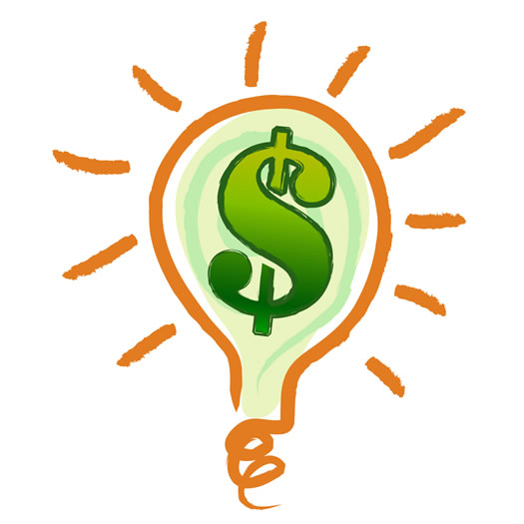
Mechanisms That Push User Adoption

Slide 7
Wait a minute….
Don’t utilities SELL energy?
How can they afford to DECREASE energy consumption?

Slide 8
Financial, Regulatory Carrots & Sticks
Traditional model: energy efficiency = lost revenue
Sell more energy → happy investors
New model: energy efficiency = resource
Recovery of program costs
Collection of lost revenues e.g. decoupling
Shareholder incentive

Slide 9
Where evaluation fits in
Rate case?
Business case
Business case
Program design & implementation
Market Assessment
Market Assessment
Process Evaluation
Impact Evaluation
Year 1
Year 2
Year 3

Slide 10
Types of energy efficiency program evaluations
Evaluation has two key objectives:
1. To document and measure the effects of a program and determine whether it met its goals with respect to being a reliable energy resource.
2.To help understand why those effects occurred and identify ways to improve current programs and select future programs.
- National Action Plan for Energy Efficiency

Slide 11
Impact evaluation - Uses
Estimates of gross energy savings
Estimates of net energy savings
Determines co-benefits (avoided emissions, health benefits, job creation, energy security, transmission/distribution benefits, and water savings)
Supports cost effectiveness analyses

Slide 12
Impact evaluation - Methods
Gross savings
Measurement and Verification
Deemed Savings
Statistical Analyses
Market Process/ Market Share
Surveys
Net savings (Free Rider & Spillover Corrections)
Surveys
Interviews
Document Analysis
Mathematical Models
Historical data from similar studies

Slide 13
The impact evaluation
tells you what you have achieved …
…the process evaluation
tells you the reasons for the achievement and what you can do to increase / improve achievements.
Notes:
13
13
13

Slide 14
Process Evaluation - Uses
Ensure accountability for program deliverables
Help program managers design / redesign programs and services
Identify staff or staffing needs / issues
Structure or revisit management and operational procedures
Refine program targets or targeting approaches
Notes:
14
14
14

Slide 15
Process Evaluation - Methods
Surveys / Interviews
Participant experience surveys & interviews
Participant satisfaction surveys & interviews
Market actor interviews
Non participant surveys & interviews
Interviews with program stakeholders, administrators, implementers
Focus Groups
Observations and enrollment/process tests
Project data & documentation reviews
Notes:
15
15
15

Slide 16
Market Assessment
Characterize baseline market conditions
Identify market needs
Understand program lifecycle
Develop key market progress indicators to assess market changes over time
Examples:
Appliance and equipment saturation studies
Program lifecycle development
Market Segmentations
Sales Profiles

Slide 17
Organizational Assessment
Assess strengths, weaknesses, opportunities of utility’s internal evaluation group
Assessment of independence
Managerial support
Placement in organization
Relationships with program staff
Appropriate standards, methods
Sufficient technical and people skills
Professional development, career path

Slide 18
Issues that may affect your work, too. Let’s chat about….
Free ridership
Spillover
Interactive effects

Slide 19
Free Ridership
Free riders are program participants who would have implemented the program measure or practice in the absence of the program.
Example:
A Small Business Owner who receives an incentive to install new high efficiency florescent lights but had planned to install these lights before participating in the program and had budgeted for the expenditure during the program year.

Slide 20
Free Ridership In Your Work
What do you call it?
How does it occur?
Does it matter?
How do you account for it (or not)?

Slide 21
Spillover
When program participants install additional energy efficiency measures or adopt new energy efficiency behaviors beyond those recommended or rebated by the program and they attribute the investment or behavior change to their participation in the program.

Slide 22
Spillover In Your Work
What do you call it in your work?
How does it occur?
Does it matter?
How do you account for it (or not)?

Slide 23
Interactive Effects
Interactive Effects refers to the increased number and type of energy efficiency programs and media messages that may influence consumer actions making the task of determining attribution that much more challenging.
Examples
Within Portfolio Interactions – Multiple programs within a single utility portfolio influencing customer actions. (i.e. a Residential Rate Program and a Residential Weatherization Program)
Within Community Interactions – Multiple programs within a single community influencing customer actions (Utility Program, Neighboring Utility Program, ARRA-funded Program)

Slide 24
Interactive Effects In Your Work
What do you call it?
How does it occur?
Does it matter?
How do you account for it (or not)?

Slide 25
Thank you!
Ellen Steiner
esteiner@emiconsulting.com
Kara Crohn
karac@researchintoaction.com

