Slide 1
The Secret to Programs that Work New Tools for Program Design and Evaluation
John Griffith
Center for American Progress
2011 Environmental Evaluators Network Forum
The George Washington University, Washington, D.C.
June 23, 2011

Slide 2
Doing What Works
The Secret to Programs that Work
Reforming government to more efficiently allocate resources and achieve greater results for the American people:
Eliminating or redesigning misguided spending programs and tax expenditures
Boosting government productivity by streamlining management and strengthening operations
Promoting smarter decision-making through enhanced transparency and performance measurement

Slide 3
The Secret to Programs that Work
“Washington, Right Now, Is Broken”
The problem:
Washington for years has been shooting at big targets and missed the mark, and at the root of many failures is faulty design.
The result:
Americans are losing faith in the federal government.
The stakes:
With shrinking budgets and limited resources, we can no longer afford avoidable mistakes.

Slide 4
Objectives
The Secret to Programs that Work
Learn more:
Why do some federal programs succeed and others fail?
Can we reform the program design and budgeting process to avoid these pitfalls in the future?
Fix the problem:
Create tools and processes to assess a program’s likelihood of success before it is approved for funding

Slide 5
The Secret to Programs that Work
Our Approach
Input from over 200 government officials and performance experts
Nine expert workshops:
Federal government | State gov. and outside experts
Office of Management and Budget | Office of MD Gov. Martin O’Malley
Senate Committee on Homeland Security and Government Affairs | Select group of about 25 government performance experts and academics
Government Accountability Office | Attendees of a CAP-sponsored conference on government reform
U.S. Department of Transportation
Presidential Management Fellows

Slide 6
The Secret to Programs that Work
Why Programs Fail
No clear idea of the outcomes the program was trying to achieve
Wrong approach to the problem altogether
Insufficient evidence it will actually work
Poor implementation planning
Established the wrong incentives
No thought of monitoring progress or rethinking the approach

Slide 7
The Secret to Programs that Work
A Checklist-Inspired Solution
“We don’t study failures in teaching, in law, in government programs, in the financial industry, or elsewhere. We don’t look for the patterns of our recurrent mistakes or devise and refine potential solutions for them. But we could.”
- Atul Gawande in The Checklist Manifesto
Our Solutions:
For new programs
“Design for Success” - Tools and processes to help sort new program ideas with a high likelihood of success from those with serious design flaws
For existing programs
“Reviewing What Works” - Tools and processes for evaluating the effectiveness of existing government programs across policy areas

Slide 8
The Secret to Programs that Work
Design for Success
Six basic questions that should be asked of every new program idea:
Are the program’s goals clear and cost estimates accurate?
Is this the right approach to address the problem?
What evidence is there that the program is likely to achieve its goals?
Does the program establish the right incentives?
Is the implementation phase likely to be successful?
How will the program monitor success?
“Some of [the Design for Success] questions may be pretty basic… But I would…give you ten-to-one odds that most of these questions have never been asked in a comprehensive way for any new government program.”
- Sen. Mark Warner (D-VA)

Slide 9
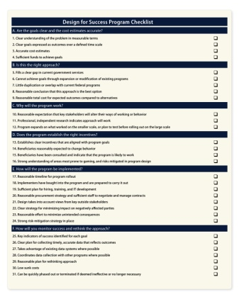
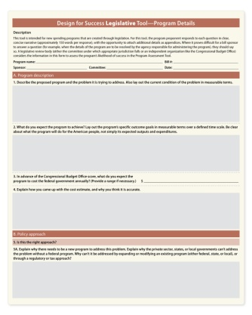
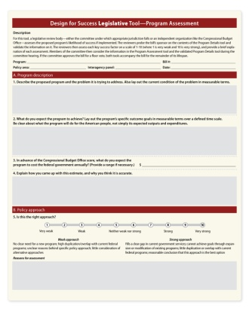
The Secret to Programs that Work
Design for Success Tools
1. Program Checklist | 2. Program Details | 3. Program Assessment
25 aspects of effective program design Guides the proponent during the design phase | 25 questions to identify possible design flaws in the proposal Proponents answer questions in concise narrative | High-level evaluation of six key aspects of program design Independent body assesses likelihood of success in each category on a scale of 1-10

Slide 10
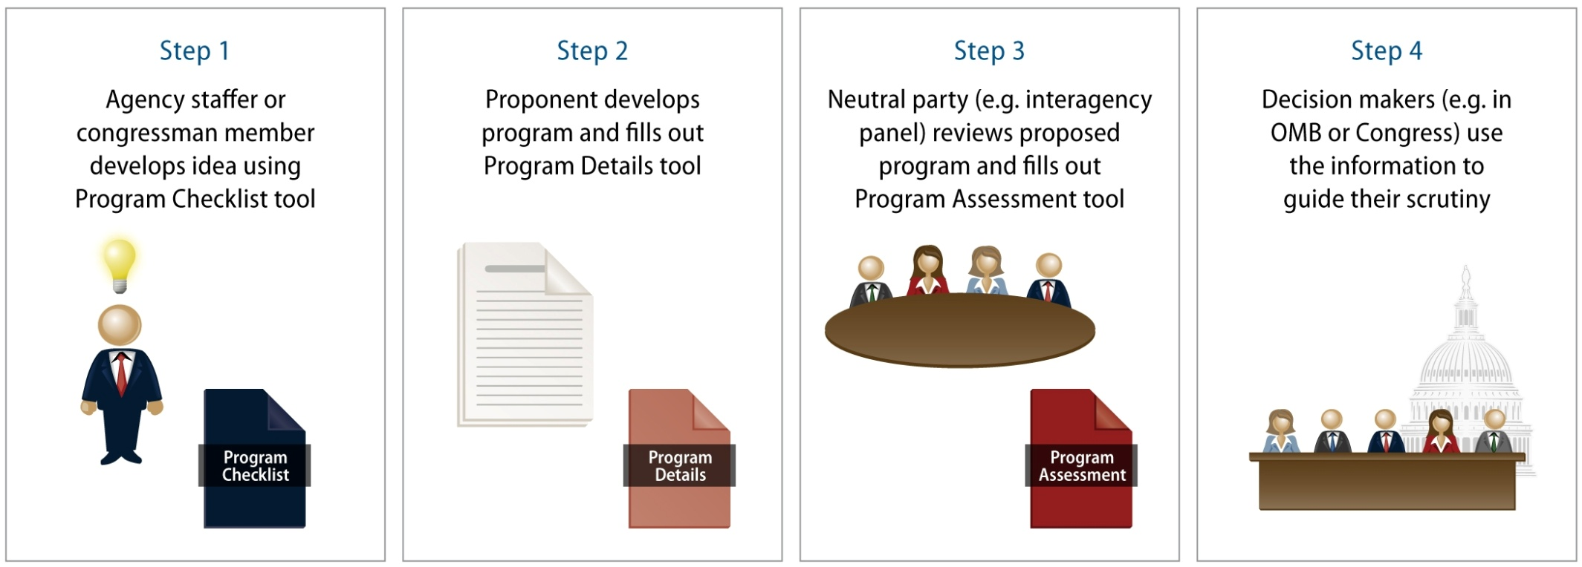
The Secret to Programs that Work
Design for Success Process

Slide 11
The Secret to Programs that Work
Design for Success in the
Real World
New programs can go down several paths to funding…
Program Checklist
Member comes up with an idea
Program Details
Member drafts legislation
Program Assessment
Independent body reviews the program
Decision made in Committee and rest of Congress
Programs developed in the Legislative Branch:
Program Checklist
Agency staffer comes up with an idea
Program Details
Agency staffer develops a program proposal
Program Assessment
Interagency panel reviews the proposal
Decision made in the agency, OMB and Congress
Programs developed in the Executive Branch:

Slide 12
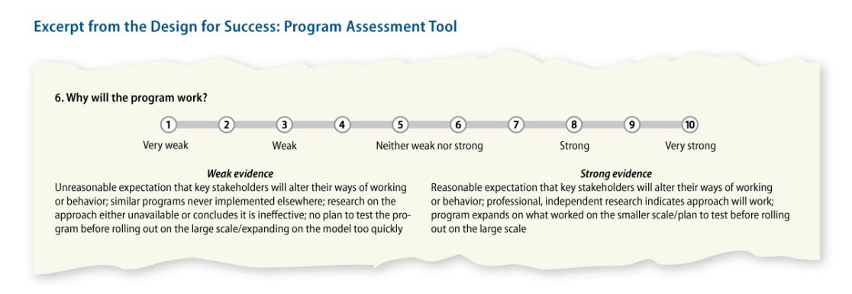
The Secret to Programs that Work
“Why will the program work?”
Stakeholder involvement
Evidence it is likely to achieve its outcome
Where else it has been implemented
Plans to test the idea or expand based on what has worked

Slide 13
The Secret to Programs that Work
Interagency Panels
STEP 1: Form interagency panels by policy area
STEP 2: Define common goals and list programs that contribute to these objectives
Example: An interagency approach to homeless assistance
U.S. Interagency Council on Homelessness
23 targeted programs
Four government-wide priority goals

Slide 14
The Secret to Programs that Work
Reviewing What Works
Six basic questions that should be asked of every existing program:
What goals across government is the program contributing to?
What impact does the program have on achieving those goals?
Does the program work well with other programs to maximize impact and minimize duplication?
How cost effective is the program compared to others?
Is the program well run? Have there been delays or cost overruns?
Does the program learn from experience and improve in response?
“As president, I will go through the entire federal budget, page by page, line by line, and I will eliminate the programs that don’t work and aren’t needed. As for the programs we do need, I will make them work better and cost less.” - Sen. Barack Obama as a presidential candidate in 2008

Slide 15
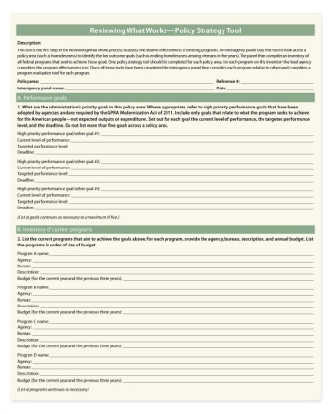
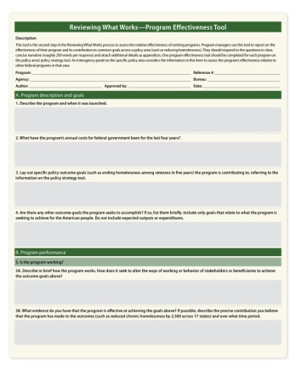
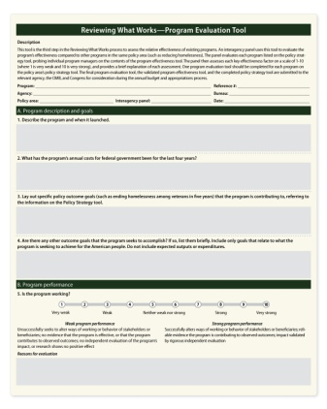
The Secret to Programs that Work
Reviewing What Works Tools
1. Policy Strategy | 2. Program Effectiveness | 3. Program Evaluation
Lay out key outcome goals for a policy area Inventory of all federal programs that seek to achieve those goals | 26 questions for program managers to report on their program’s effectiveness Lay out the program’s contribution to goals across a policy area | High-level evaluation of nine key aspects of program performance Independent body assesses performance in each category on a scale of 1-10

Slide 16
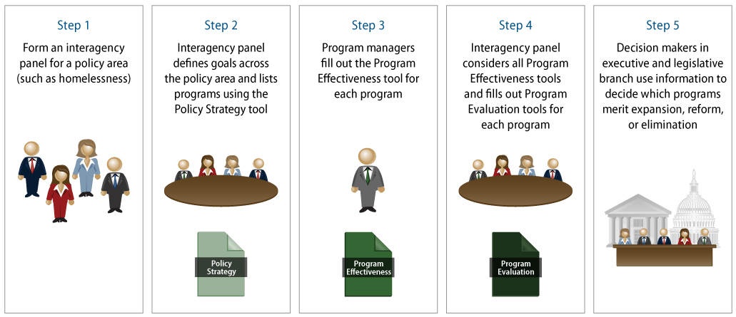
The Secret to Programs that Work
Reviewing What Works Process

Slide 17
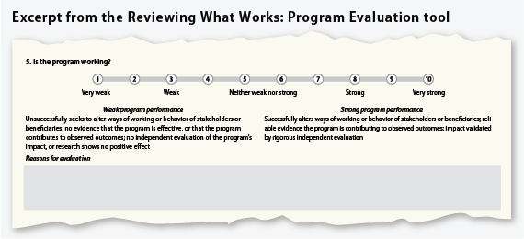
The Secret to Programs that Work
“Is the program working?”
How it alters the actions or behavior of stakeholders or beneficiaries
Evidence that the program is achieving its goals
How it has contributed to the observed outcomes
Independent evaluations of program impact and effectiveness

Slide 18
The Secret to Programs that Work
Recent Performance Initiatives
OMB’s Program Assessment Rating Tool (2002-2009)
GPRA Modernization Act of 2010
Pros | Cons
Thoughtful, carefully-designed questions Over 1,000 programs reviewed Comprehensive (program design, management, impact, etc.) | Siloed, looked at each program on its own Exclusive, too much power given to OMB examiners Only applies to existing programs
Pros | Cons
Gets Congress involved Outcome-based agency and cross-government priority goals Regular performance monitoring | No common framework for assessing performance and impact Focus still on agencies Only applies to existing programs

Slide 19
The Secret to Programs that Work
A Time to Act
With limited resources, we can no longer afford to dedicate funds to programs that are designed to fail.
Design for Success helps to flag programs with serious design flaws and identify the most promising new programs before the funding decision is made
As budgets tighten, we need to base funding decisions on an understanding of which programs actually work.
Reviewing What Works helps to assess the relative effectiveness of all existing programs in a policy area

Slide 20
The Secret to Programs that Work
Next Steps
Test on the small scale
Modify the model to fit state and local governments
Establish interagency panels for individual policy areas on the federal level
Monitor impact, tweak the model, and scale it up appropriately
“Openly measuring the performance of our public institutions, and communicating that performance to citizens, has never been more important. The states that win will be the states that...manage for results.“
- Maryland Gov. Martin O’Malley

Slide 21
The Secret to Programs that Work
Discussion
Questions?
General reactions?
Thoughts on our strategy moving forward?
Special thanks to my co-authors on the report:
Jitinder Kohli, Senior Fellow at CAP
William D. Eggers, Director for Deloitte Research
** Please send any follow-up questions or comments to:
jgriffith@americanprogress.org

