Slide 1
Wildlife TRACS, the Project Cloud and Archetypal Conservation Actions Developing IT Systems and Standards to Promote Cross-Project Sharing & Learning
TM
Notes:
This presentation has been developed by Foundations of Success.
This work is licensed under the Creative Commons Attribution-Noncommercial-Share Alike 3.0 License. To view a copy of this license, visit http://creativecommons.org/licenses/by-nc-sa/3.0/.

Slide 2
Overview of this Presentation
Wildlife TRACS
The Conservation Project Cloud
Archetypal Conservation Actions

Slide 3
About Foundations of Success
Our Structure
Non-profit organization
Our Mission
To improve the practice of conservation: We don’t implement conservation projects, we make conservation projects better!
Our Strategy
Work with practitioners of all kinds to improve the design, management, monitoring, and learning from conservation projects and programs

Slide 4
The Conservation Measures Partnership: Leading Conservation Organizations

Slide 5
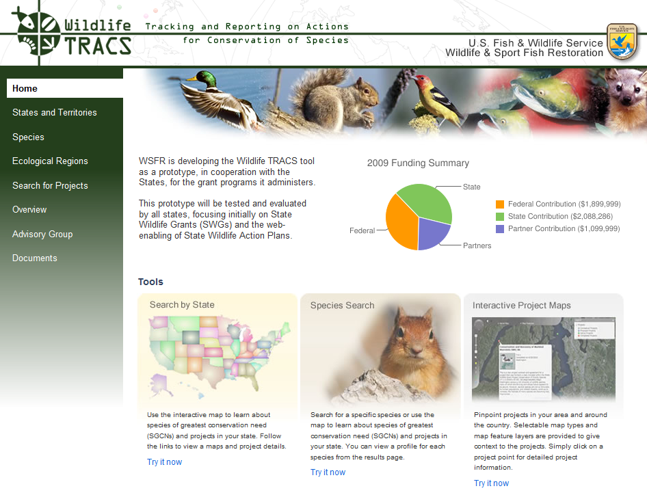
WILDLIFE TRACS Database

Slide 6
WHAT IS WILDLIFE TRACS?
Wildlife TRACS: New Performance Tracking and Reporting Tool of USFWS WSFR
Maps and displays projects and actions in a geospatial environment with multiple GIS layers
Public viewing portal and multiple data entry portals
Tracks and reports project outputs, effectiveness measures, and species and habitat status
Facilitates strategic conservation through decision support, open standards, shared data, and networking among the States, Territories and Service

Slide 7
WILDLIFE TRACS ARCHITECTURE Two Databases, One Seamless System

Slide 8
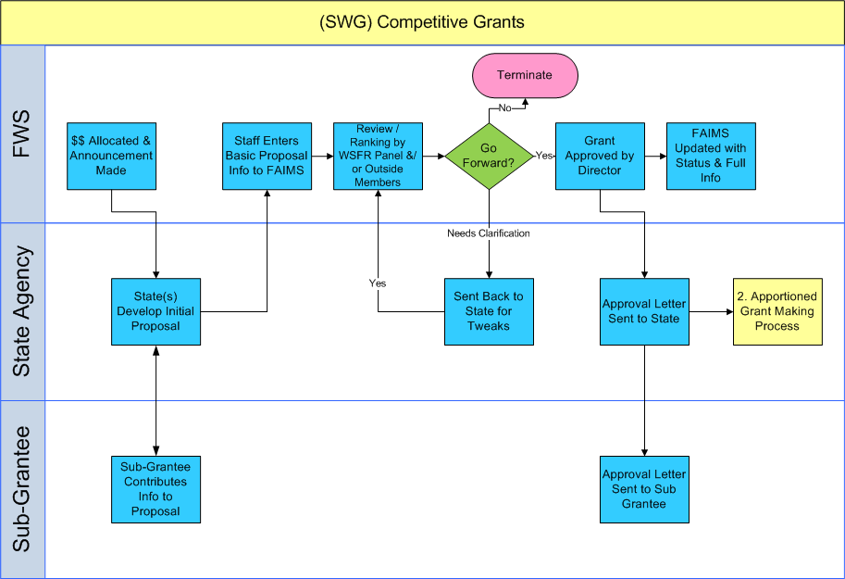
Need to Integrate Data Collection Into Biz Processes

Slide 9
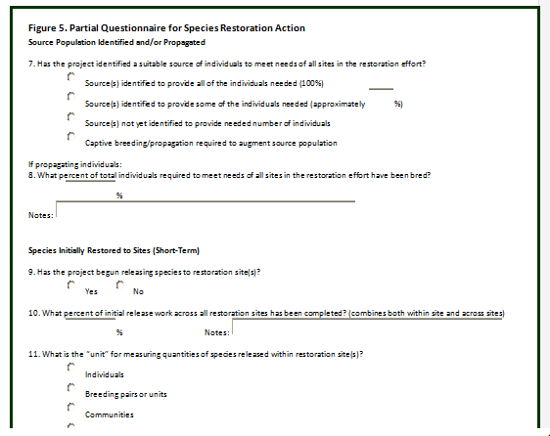
Questionnaire
Questionnaire
This is all most
folks would see for
performance reporting
purposes!!

Slide 10
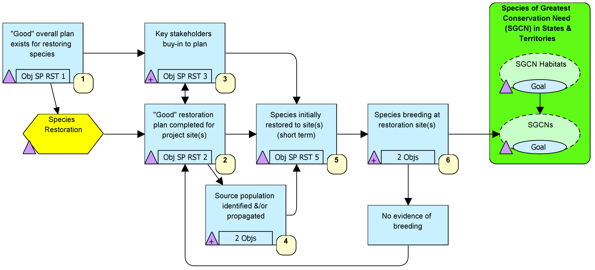
But for Learning…
TM
Adaptive Management Software
for Conservation Projects

Slide 11
Overview of this Presentation
Wildlife TRACS
The Conservation Project Cloud
Archetypal Conservation Actions

Slide 12
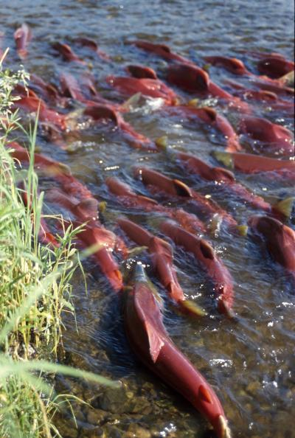
Status Question: How are Species and Ecosystems Doing?
?

Slide 13
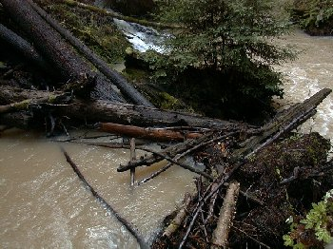
Effectiveness Question Are Our Actions Leading to Desired Results?
?
Notes:
Does dumping woody debris in a stream improve spawning habitat for salmon? How can we improve these actions over time?

Slide 14
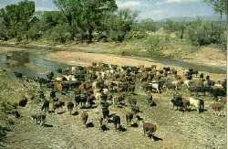
We Need Standard Terms to Describe Conservation Projects
Cows?
Cattle?
Livestock?
Grazing?
Ranching?

Slide 15
Two Independent Systems Have Now Been Unified
IUCN Red List Authority Files
CMP Taxonomies
Unified Global Classifications

Slide 16
Hierarchical Classifications

Slide 17
Hierarchical Classifications

Slide 18
Hierarchical Classifications

Slide 19
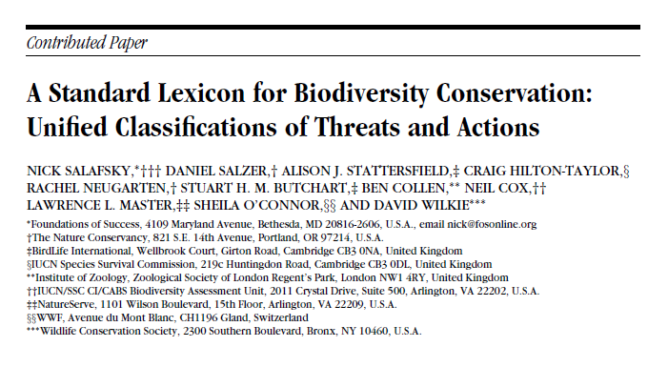
For More Information: Conservation Biology 22: 897-911 (2007)

Slide 20
Projects and Especially Actions as the Basic Unit of Learning
TM
Adaptive Management Software
for Conservation Projects
Actions are:
Unit of work
More likely to share failures

Slide 21
How Do We Share Individual Experiences?
Click me…

Slide 22
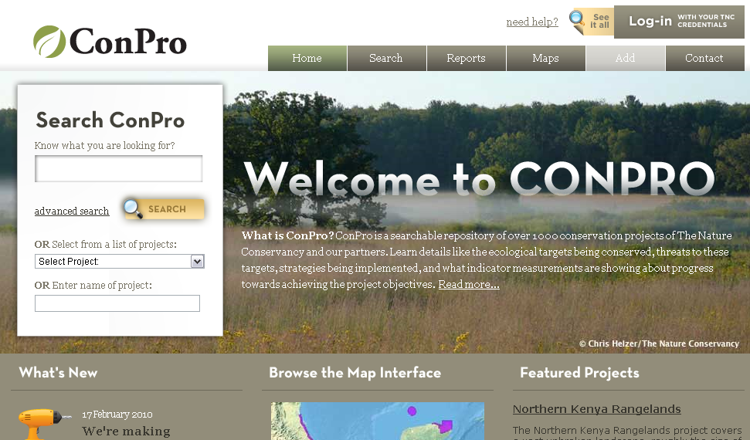
TNC’s ConPro Database

Slide 23
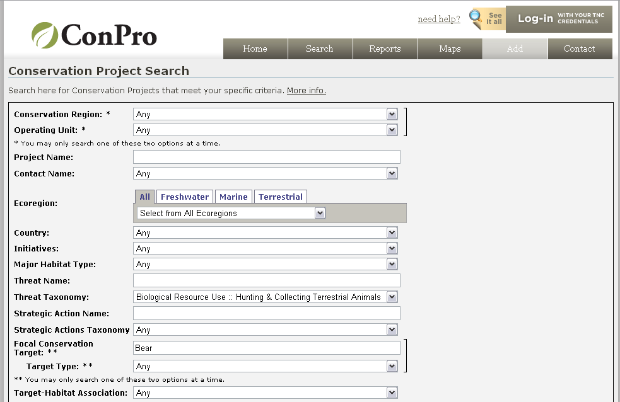
TNC’s ConPro Database
Threat: Hunting
Target: Bears

Slide 24
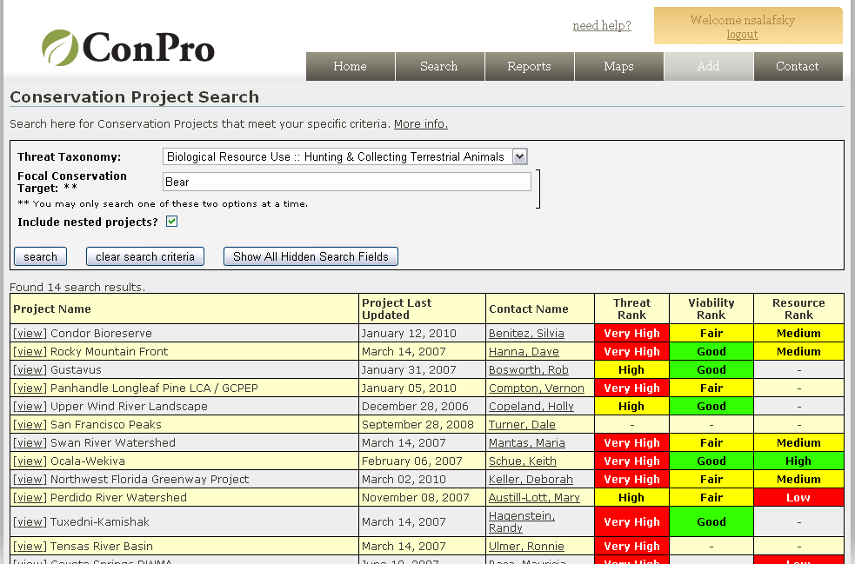
ConPro Finds Projects That Match Criteria

Slide 25
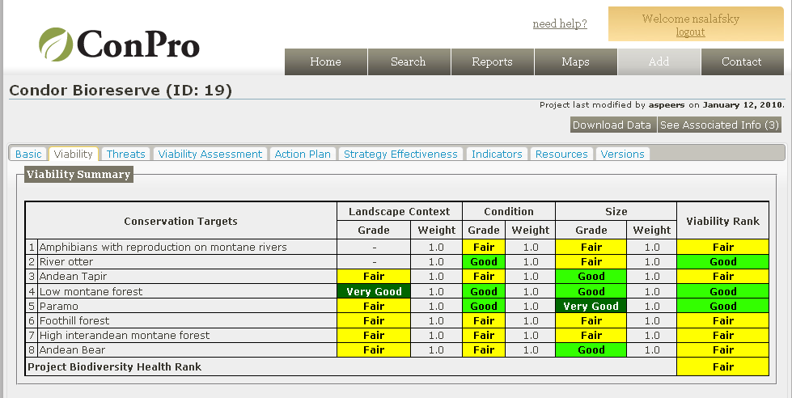
…and Lets You See Details

Slide 26
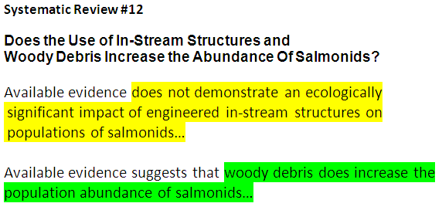
If We Create a Culture of Data Sharing…
☑
?

Slide 27
But We Have a Problem: ConPro & TRACS are Only Two of Many Nascent Databases
TNC’s ConPro
FWS Wildlife TRACS
WWF Insight
Rare Planet
Conservation Evidence.com
DataBasin
Conservation Registry
National Geographic Action Atlas
Rainforest Alliance EcoIndex
Protected Area databases
etc….

Slide 28
Info Mngmt Systems Must Meet Both Single Org & Global Needs
There can be many sources of experience and ways of synthesizing it, but the world needs access to all relevant experience
There are large financial and programmatic inefficiencies if each org builds its own database.

Slide 29
Conservation Effectiveness Data Exchange (CEDEx) Standards
Action/Strategy: Interventions designed to reach a project’s objectives and ultimate conservation goals. For example using herbicide to treat an invasive species, establishing a dive tourism business, or setting up a protected area.
Field | Priority | Type | Comments
Action Type | 4 | list | Single selection; Based on IUCN-CMP Actions Classification, Level 2
Action Name | 4 | text | Equivalent of IUCN-CMP Level 3
Action Scale | 3 | text | Scope of the action
Action Cost | 3 | text | Cost per action (per year if needed)
Objective(s) | 2 | text | The specific objectives that project wants to achieve with the action
Action Detail | 2 | text | Additional description of action

Slide 30
We Must Meet Needs of Orgs that Don’t Have Their Own System…

Slide 31
…and Create a Global Sharing Mechanism Across Existing Data Systems

Slide 32
Standard Data Instead of One Common Database
Standard Data Fields – The data fields that needs to be collected for each strategy and/or project.
Database Access Rights – The terms that participating databases must agree regarding the mutual exchange of information.
Conservation Project Info Cloud – Web services that enable users to interact with all participating databases.

Slide 33
Key Potential Functions Allow Users To….
Practitioners achieve better results-based conservation management:
Use Open Standards in a collaborative fashion, even at distance
Employ tools functions that are only available in an online environment
Search for, download, and learn from work done by other project teams
Managers and funders have better information and increased transparency:
Track project/strategy locations (aka registry), implementation, (aka action tracking), and effectiveness (aka performance monitoring
Share/mirror key objects, and roll-up data across projects
Export project data to other databases to reduce transaction costs
The Conservation Community is able to share info and learn:
Analyze project data and create new reports based on this information
Provide a forum for diffusing and sharing innovations and best practices

Slide 34
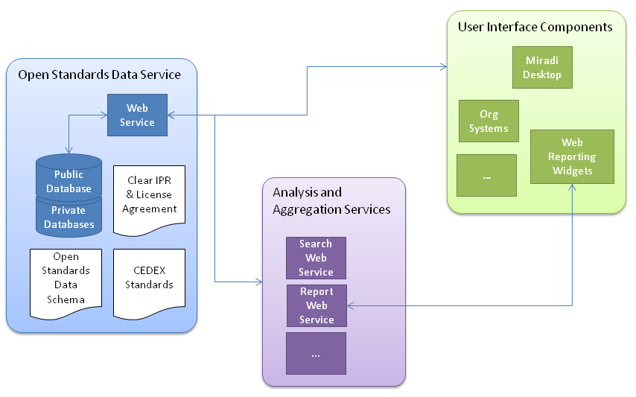
The Conservation Project Information Management Cloud

Slide 35
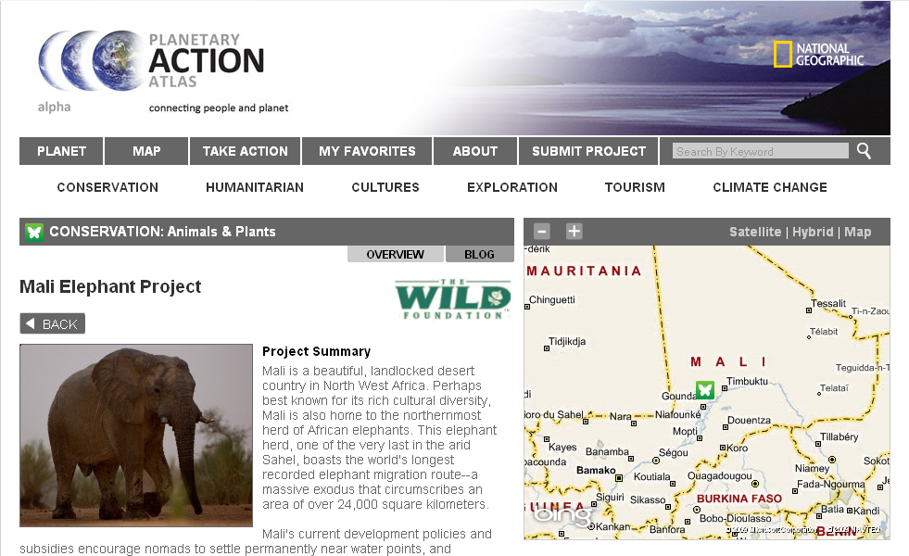
The Cloud Could Feed Strategy & Project Data to These Websites
Details

Slide 36
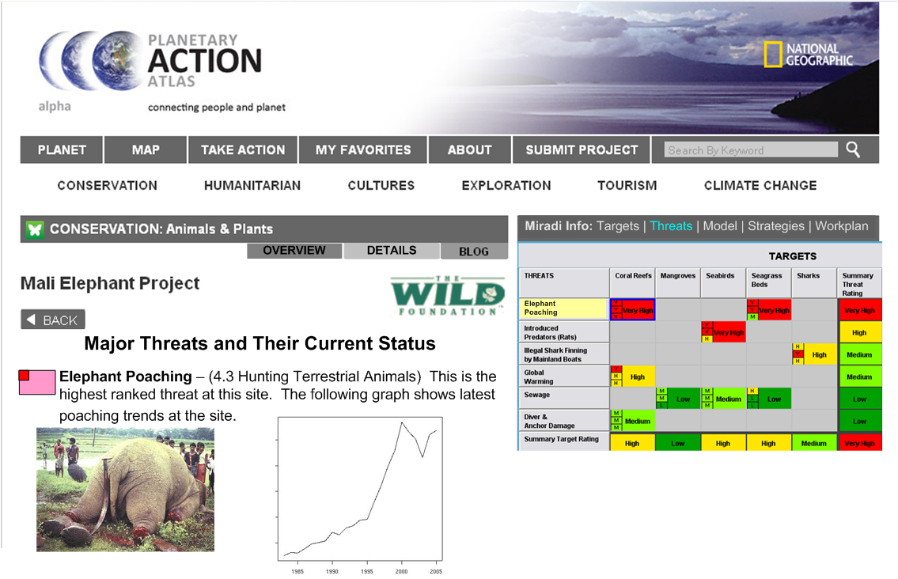
Imagine a “Details” Tab Containing Info For Project Team & Donors
Notes:
Note the graphic and disturbing image – we should figure out ramifications for public viewers…..
We also need to figure out how much is an “automatic feed” vs designed views for each page.

Slide 37
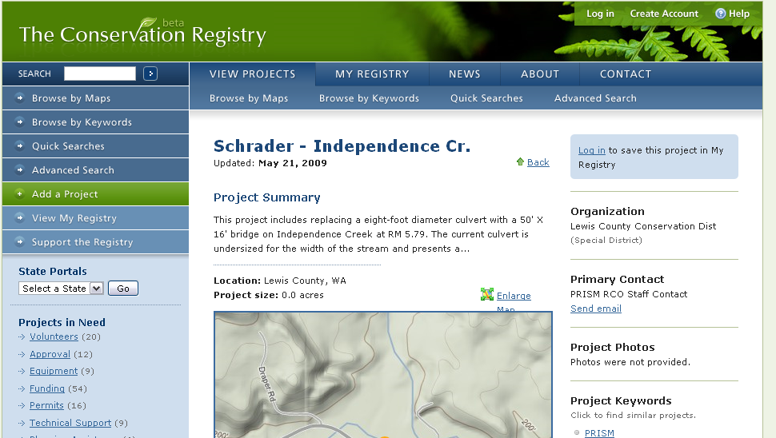
Imagine a “Details” Tab Containing Info For Project Team & Donors
Details

Slide 38
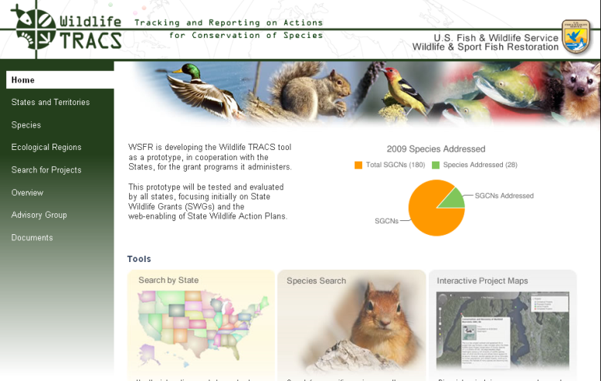
Wildlife TRACS
Integrating measures into regular business processes…
Details

Slide 39
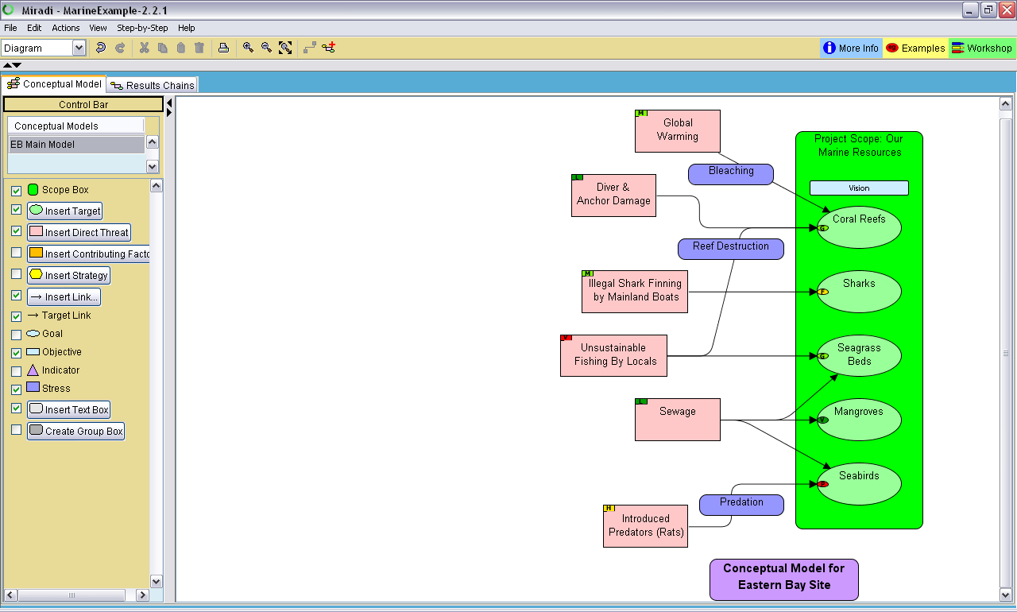
Or Imagine A Pop-Up Link in Miradi…
Click here…

Slide 40
Overview of this Presentation
Wildlife TRACS
The Conservation Project Cloud
Archetypal Conservation Actions

Slide 41
We Now Have Archetypal Results Chains for 11 Conservation Actions…

Slide 42
What About the Rest?
Click me…

Slide 43
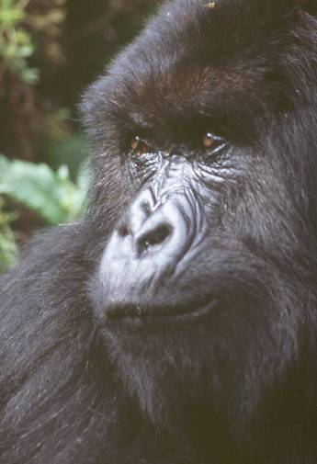
Who Establishes Standards?
Everyone

Slide 44
IT Systems and Standards are Transforming the Practice of Conservation
Practitioners, managers, and donors using TRACS, ConPro, etc. to efficiently track and report on projects
All stakeholders using these systems to share results and learn from each other
Development of archetypal actions that represent the accumulation of our collective knowledge
Ultimately, better conservation outcomes

Slide 45
More Information
www.FOSonline.org
nick@FOSonline.org
www.ConservationMeasures.org
www.Miradi.org
http://conpro.tnc.org
CMP

Slide 46
“Voluntary” Standards Can Be Amazingly Powerful Change Agents
Investment Prospectus
Company A
Investment Prospectus
Company B
Investment Prospectus
Company C
GAAP
Certified
GAAP
Certified

Slide 47
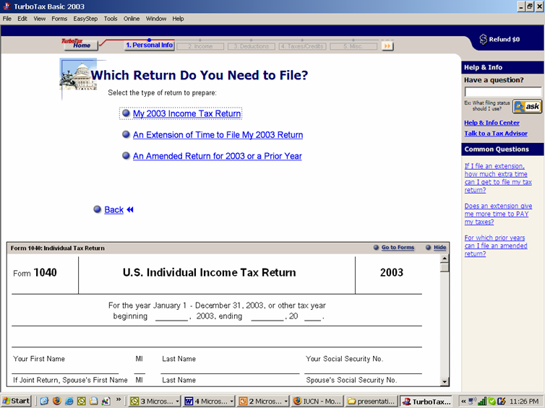
“Turbo Tax” for Conservation
Notes:
Describe how Turbo Tax works

Slide 48
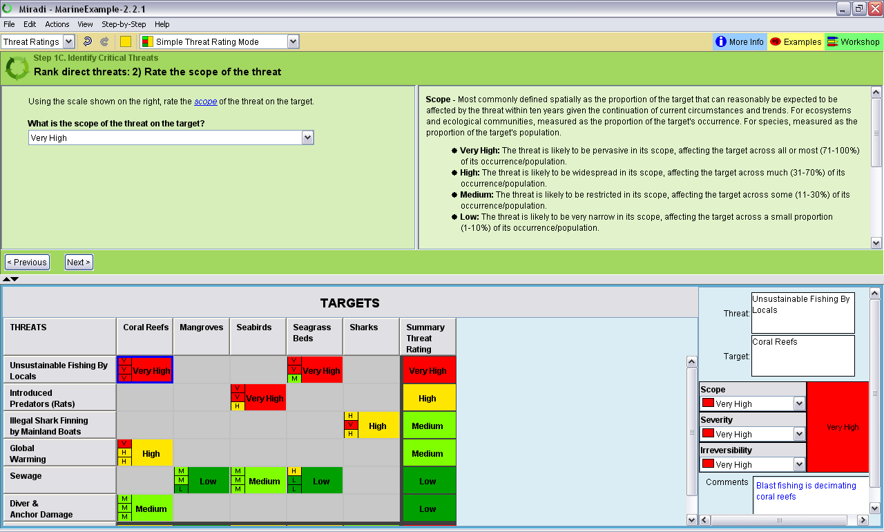
Step-by-Step Interview

Slide 49
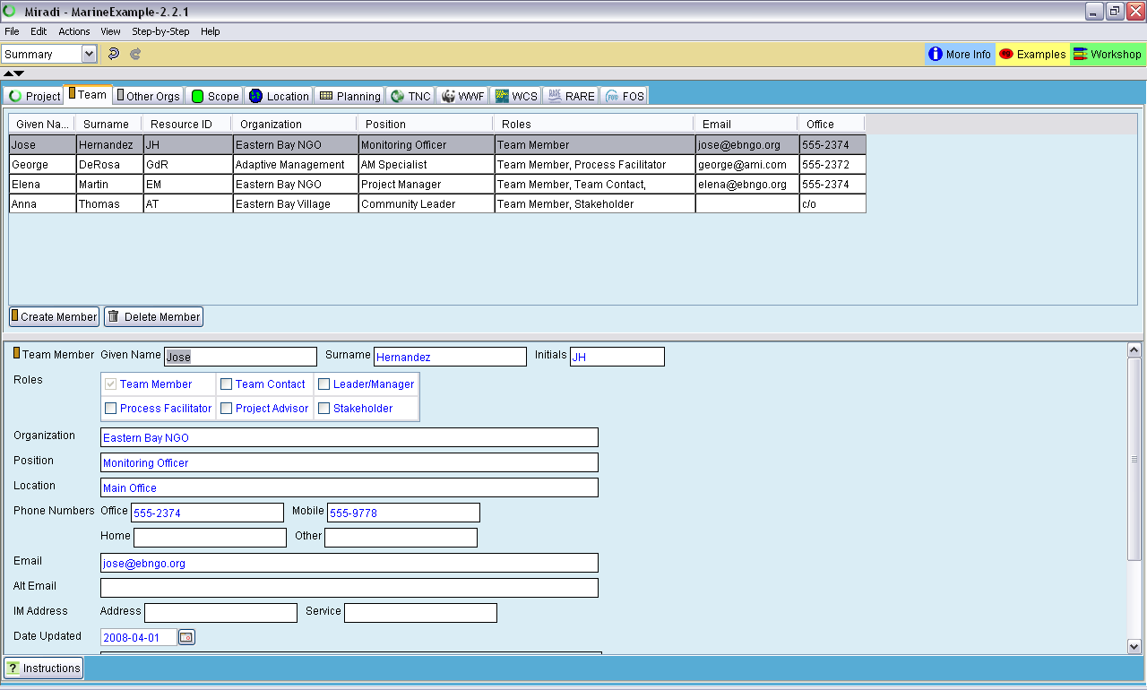
Summary View

Slide 50
Diagram View

Slide 51
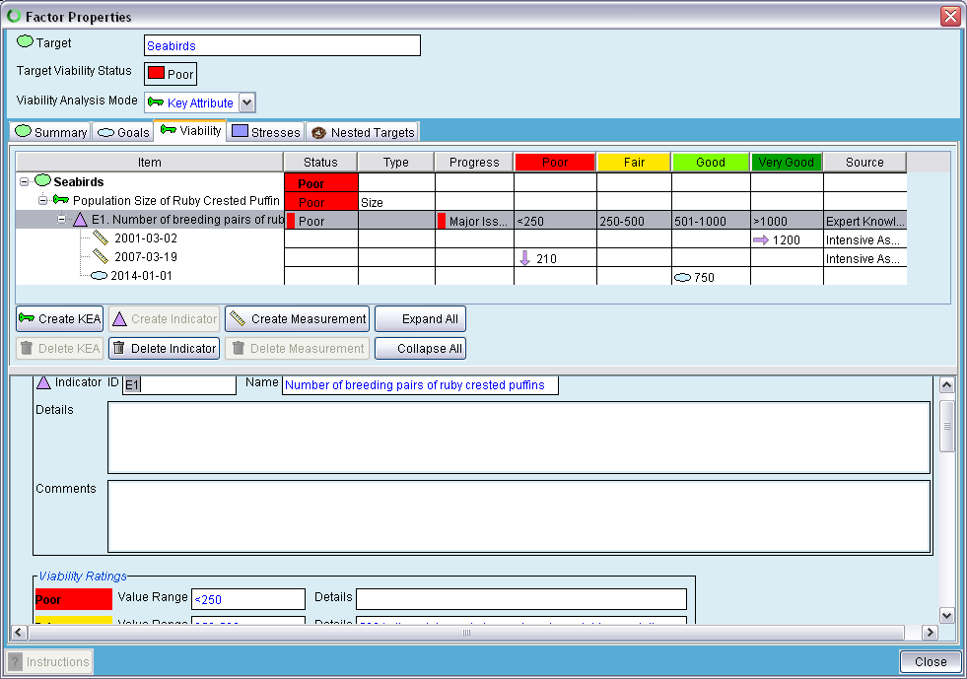
Detailed Viability Analysis

Slide 52
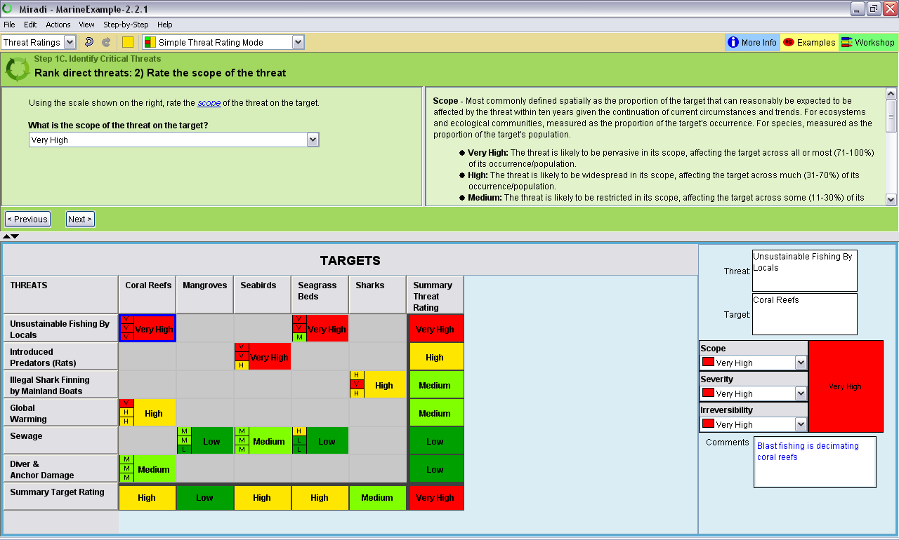
Threat Rating View
Notes:
This is your cue to show the eAM demo

Slide 53
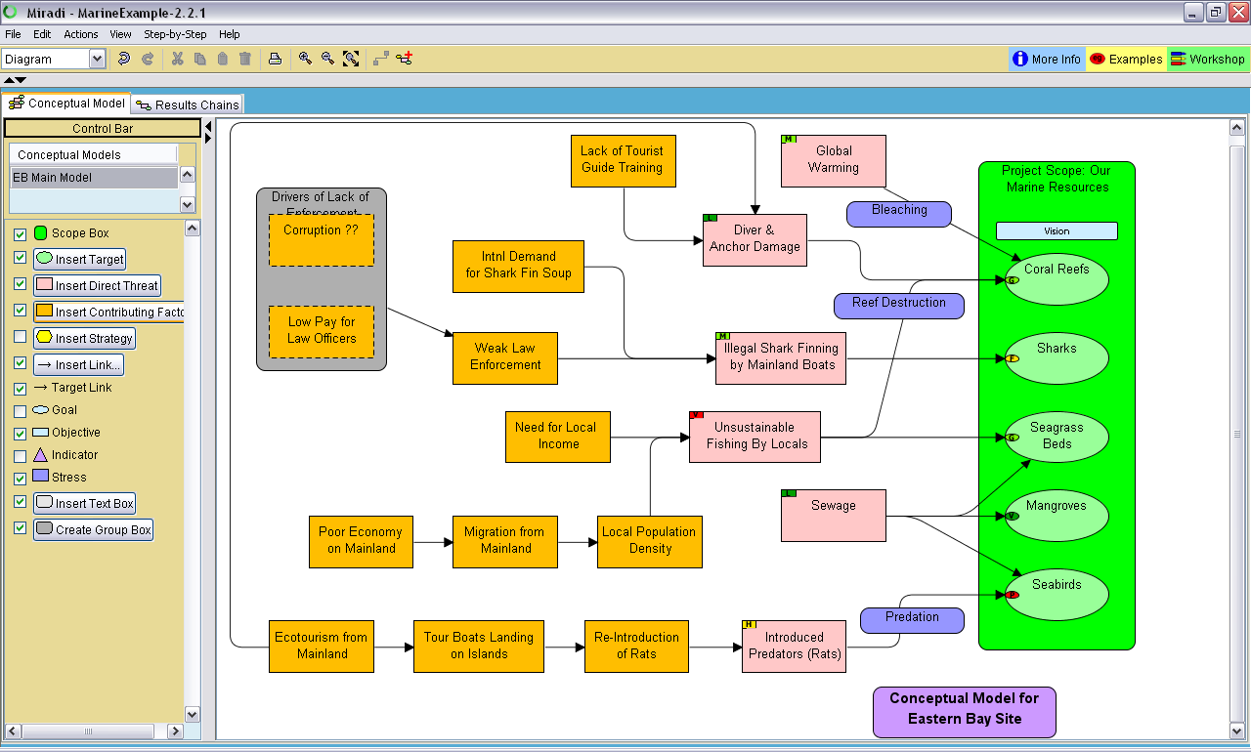
Summary Info in Diagram View
Yellow Box = High Threat

Slide 54
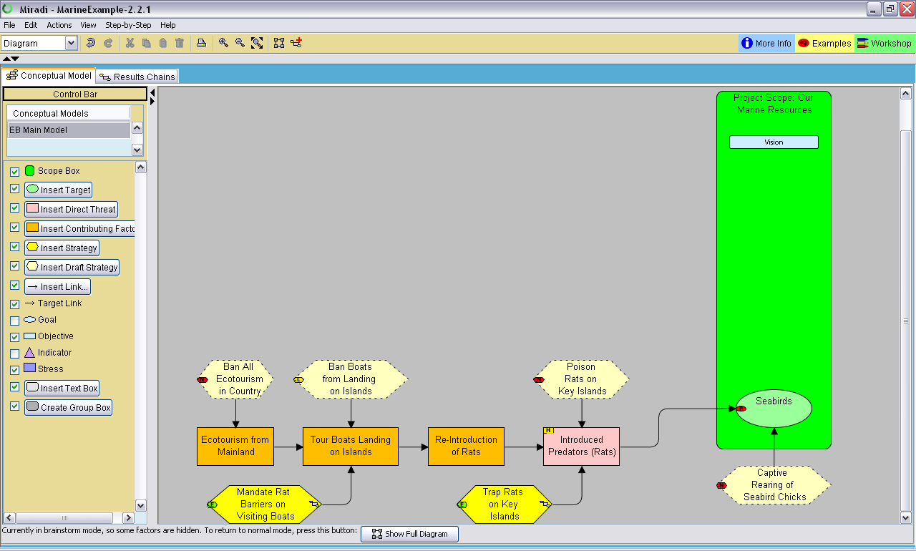
Strategic Planning Brainstorming View
Notes:
This is your cue to show the eAM demo

Slide 55
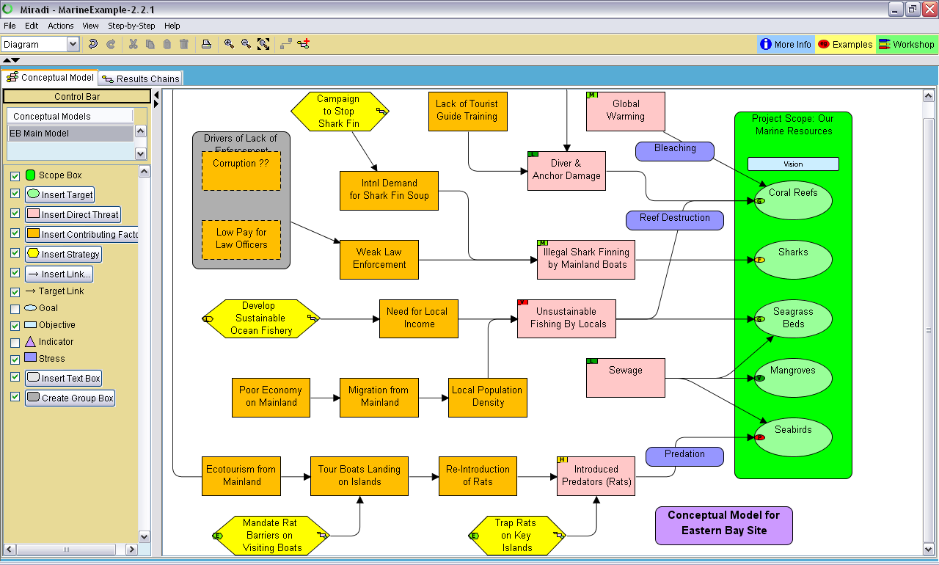
Adding Strategies to Diagram

Slide 56
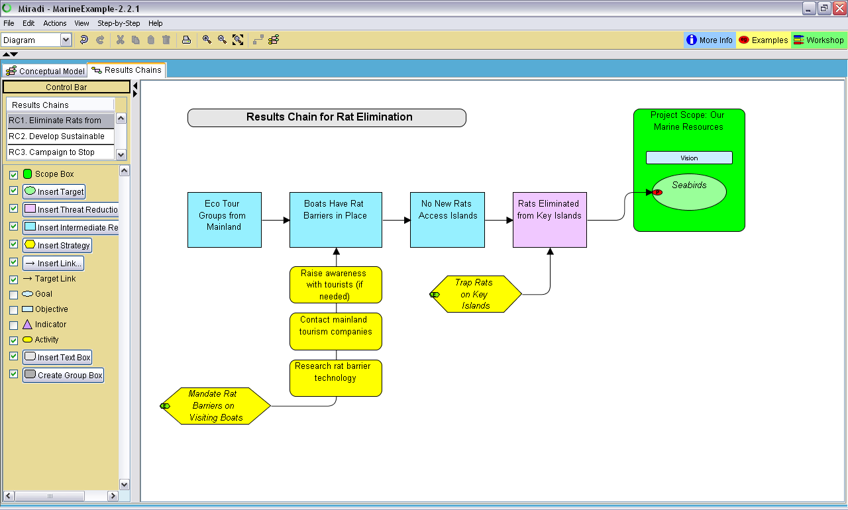
Results Chains

Slide 57
Goals, Objectives & Indicators
Obj RAT 2 – By June 2009, all tour boats have rat barriers in place.
Ind E1: Number of breeding pairs of ruby crested puffins

Slide 58
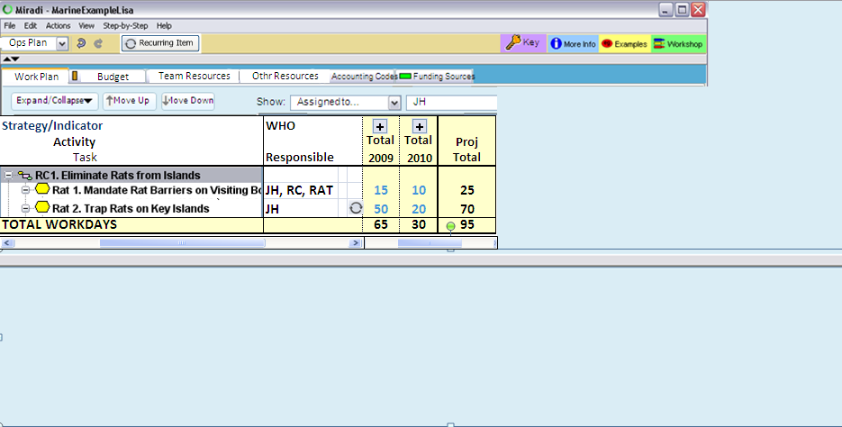
Miradi’s New Workplanning View
JH, RC, RAT
JH
Blue text is user entered
Black text is non-editable (roll-ups & totals)
Notes:
Decision: 3.0 workplanning in days only. Still need converters.

Slide 59
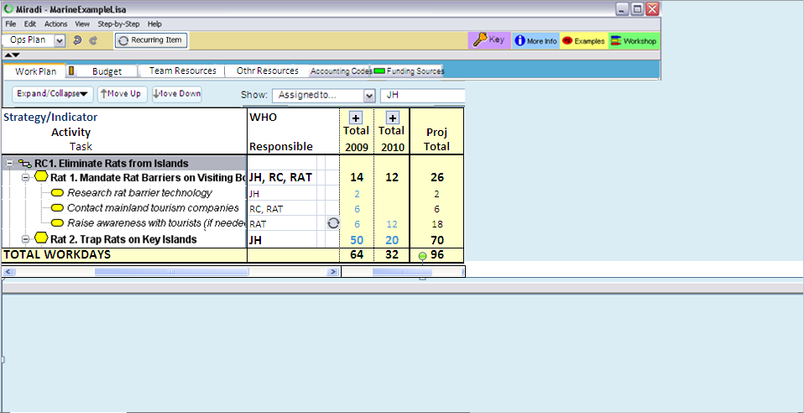
Users Can Expand Strategies to Activities, Tasks, or Sub-Tasks (rows)….
Similar expansion can be made across time scales
JH
RC, RAT
RAT
JH

Slide 60
Strong Reporting Capabilities
Easy to export images, tables, RTF documents, or XML links to databases
Will contain standard templates for major donors and can dramatically reduce transaction costs
Coupled with pre-loaded threat/action classifications, becomes basis for cross-project learning

